Slide 1
Last Reviewed October 2021
Transitioning from Active Duty to Retirement
Health Care Coverage Options As You Approach Retirement
www.health.mil/tricarebriefings
January 2023

Slide 2
Transitioning From Active Duty To Retirement
Today’s AGENDA
Preparing for Retirement
TRICARE ® Program Options
TRICARE Benefit Information
For Information and Assistance

Slide 3
Today’s AGENDA
Preparing for Retirement
TRICARE Program Options
TRICARE Benefit Information
For Information and Assistance

Slide 4
Keep DEERS Information Up To Date
Being able to use TRICARE depends on keeping DEERS up to date. Update DEERS after you have a life event, like getting married or divorced, moving, giving birth, adopting a child, retiring, and other changes.
Go to an ID card office. Find an office at www.dmdc.osd.mil/rsl.
Note: You must use this option to add family members in DEERS.
Log on to https://milconnect.dmdc.osd.mil.
Call 1-800-538-9552.
Fax 1-800-336-4416.

Slide 5
Get TRICARE Correspondence on milConnect
You can get email alerts on changes to your benefit from the Defense Manpower Data Center. These emails will send you to milConnect to view enrollment or coverage status changes. If you don’t have an email address on file, or if you opt out of email alerts, you’ll get postcards in the mail that ask you to log in to milConnect to view updates.

Slide 6
TRICARE Eligibility after Retirement
Retired service members
Spouses, surviving spouses, and qualifying former spouses
Unmarried dependent children (certain eligibility requirements apply)
Dependent parents are not eligible for civilian TRICARE benefits; however, they may be eligible to receive care at certain military hospitals and clinics if space is available.
For more information, visit www.tricare.mil/retiring.

Slide 7
Medicare-Eligible Family Members
To remain eligible for TRICARE, you must be entitled to Medicare
Part A and have Medicare Part B:
– Sign up for Medicare Part B before your sponsor’s retirement date to avoid a break in TRICARE coverage. Medicare Part B is effective the month after you enroll.
Beneficiaries under age 65 who are entitled to Medicare Part A and
have Part B may:
– Enroll in TRICARE Prime (enrollment fee waived)
– Be covered by TRICARE For Life (TFL)
For Medicare information, visit:
– www.ssa.gov
– www.medicare.gov

Slide 8
The Affordable Care Act
TRICARE meets the minimum essential coverage requirement under the Affordable Care Act (ACA).
Each tax year, you will get an Internal Revenue Service (IRS) Form 1095 from your pay center. It will list your TRICARE coverage for each month.
Your Social Security number (SSN) and the SSNs of each of your covered family members should be included in DEERS for your TRICARE coverage to be reflected accurately.

Slide 9
Terminal Leave Status
Current TRICARE program options stay in effect until your
retirement date. If covered under TRICARE Prime:
– Active duty service members (ADSMs) cannot enroll with another military hospital or clinic.
– ADSMs cannot switch their primary care manager (PCM).
If you move to a new area:
– Coordinate all care with your current PCM.
– Family members may be able to change their PCMs.
Remember to update your information in DEERS.

Slide 10
Today’s AGENDA
Preparing for Retirement
Managed Care Support Contractors [MCSC]
TRICARE Benefit Information
For Information and Assistance

Slide 11
TRICARE Stateside Regions
East Region
Humana Military
1.800.444.5445
HumanaMilitary.com
www.tricare-east.com
West Region
Health Net Federal Services
1.844.866.9378
www.tricare-west.com
Note: For more information on TRICARE changes visit: www.tricare.mil/changes
Notes:
TRICARE is available worldwide and managed regionally. There are two TRICARE regions in the United States—TRICARE East and TRICARE West—and one overseas region with three areas—TRICARE Eurasia-Africa, TRICARE Latin America and Canada, and TRICARE Pacific. Benefits are the same regardless of where you live, but there are different customer service contacts for each region.
Health Net Federal Services, LLC administers the benefit in the West Region and Humana Military administers the benefit in the East Region. Both regional contractors partner with the Military Health System to provide health, medical, and administrative support including customer service, claims processing, and prior authorizations for certain health care services.
Contact information for each region will be provided at the end of this presentation.

Slide 12
What Is TRICARE?: TRICARE Overseas Program
International SOS: www.tricare-overseas.com
1.877.678.1208
1.877.451.8659
1.877.678.1207
Notes:
The TRICARE Overseas Program, or TOP, is the Department of Defense health care program for eligible beneficiaries living in geographical areas and territorial waters outside the United States.
There is one overseas region divided into three geographic areas—TRICARE Latin America and Canada, TRICARE Eurasia-Africa, and TRICARE Pacific.
International SOS Government Services, Inc., or International SOS, is the regional contractor that administers the TOP benefit.
Contact information for your area will be provided at the end of this presentation.

Slide 13
Today’s AGENDA
Preparing for Retirement
TRICARE Program Options
TRICARE Benefit Information
For Information and Assistance

Slide 14
TRICARE Timeline
Active Duty or AGR Retirement
Same as Active Duty
Retirement
Age 65
PRIME / TPR / Select
Select or Prime
TFL
Join
Time Line
Traditional NG or Reservist Retirement
20 Year Retirement Letter and on Retirement rolls
Age 60
Age 65
TFL
TRS
TRR
Select or Prime
“Gray Area Retirement”

Slide 15
Program Comparisons
TRICARE Prime® | TRICARE Select®
A health maintenance organization (HMO)- style plan | A preferred-provider plan (PPO)-style plan
Get most care from a primary care manager (PCM) | Choose your TRICARE-authorized provider
Referrals for specialty care | Referrals not required for most services
Prior authorization for some services | Prior authorization for some services
Receive care from an established network of doctors and other health care providers | Receive care from any provider, but pay higher out-of-pocket costs when you receive care outside the established network of providers
No deductible applies, copayments apply for all beneficiaries except active duty service members | Deductible and copayments apply

Slide 16
TRICARE Coverage for Retirees
You must enroll in a TRICARE Prime or TRICARE Select plan to
continue coverage.
You may enroll:
– Online: Use Beneficiary Web Enrollment by logging in to
https://milconnect.dmdc.osd.mil (Stateside enrollment only).
– Phone: Call your regional contractor (once your retired status is reflected in DEERS).
– Mail: Download the appropriate enrollment form at www.tricare.mil/forms and mail it to your regional contractor.
For enrollment fees, premium amounts, and copayments, visit
www.tricare.mil/costs.
Note: TRICARE Prime Remote options and TRICARE Overseas Program Prime options are not available after retirement.

Slide 17
Enrollment Options
TRICARE Open Season
TRICARE Open Season is the annual period when you can enroll in or change your health care coverage plan for the following year.
TRICARE Open Season applies only to enrollment in TRICARE Prime and TRICARE Select health plans.
TRICARE Open Season occurs each fall, from the Monday of the second full week in November to the Monday of the second full week in December.
Enrollment changes made during the TRICARE Open Season go into effect on Jan. 1.
Visit ww.tricare.mil/openseason.
Qualifying Life Event
A Qualifying Life Event (QLE) is a certain change in your life that means different TRICARE health plan options may be available to you and your family.
Following a QLE, you have 90 days to make eligible health plan enrollment changes.
A QLE for one family member means all family members are eligible to make enrollment changes.
Examples of TRICARE QLEs include: getting married or divorced, moving, giving birth, adopting a child, and retiring.
Visit www.tricare.mil/lifeevents.

Slide 18
Qualifying Life Events
The following are TRICARE Qualifying Life Events:
– Change in sponsor status that results in ineligibility to continue existing coverage
– Change in family composition
– Moving (change of address)
– Certain government-directed changes
– Change in command sponsorship (overseas only)
– Losing sponsor or family member eligibility
– Change in eligibility status of any single family member in another family
– Losing other health insurance
For more information, visit www.tricare.mil/lifeevents.

Slide 19
Enrollment Options following a Qualifying Life Event
Depending on your eligibility, a Qualifying Life Event (QLE)
may allow you and your family to:
– Enroll in a new TRICARE health plan. – Change your health plan coverage.
If you want to enroll in or change your health plan, you must:
– Update the Defense Enrollment Eligibility Reporting System (DEERS) with the QLE.
– Make the eligible enrollment changes within 90 days following the QLE.
– Pay any enrollment fees or premiums due during the QLE period.
For information on QLEs, visit www.tricare.mil/lifeevents.

Slide 20
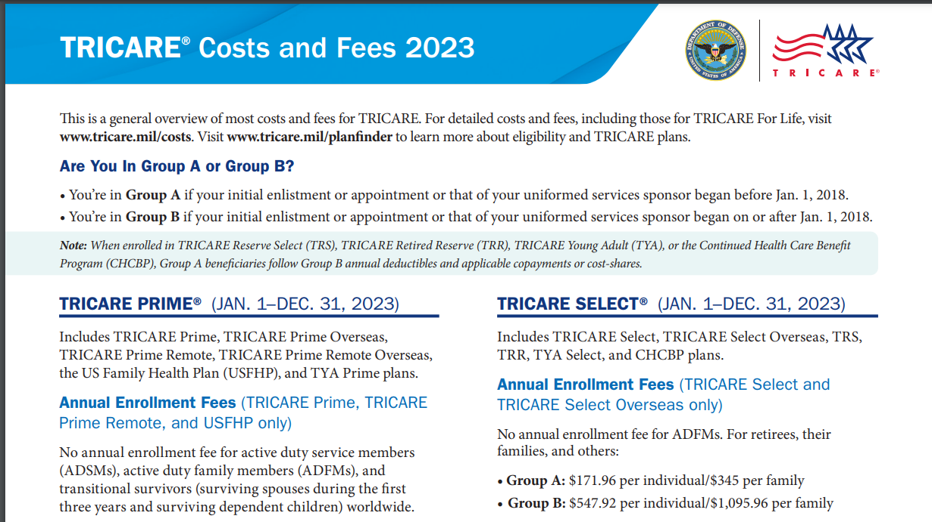
www.Tricare.mil/publications
Cost and Fees 2023

Slide 21
Beneficiary Categories: Group A and Group B
All beneficiaries fall into one of two categories based on when you or your sponsor entered the uniformed services. Each group pays different costs and fees.
Group A: If your or your sponsor’s initial enlistment or appointment occurred before Jan. 1, 2018, you are in Group A.
– While enrolled in a premium-based plan (TRICARE Reserve Select, TRICARE Retired Reserve, TRICARE Young Adult, and the Continued Health Care Benefit Program), Group A beneficiaries follow Group B deductibles, cost-shares, and catastrophic caps.
Group B: If your or your sponsor’s initial enlistment or appointment occurred on or after Jan. 1, 2018, you are in Group B.

Slide 22
TRICARE Select
TRICARE Select is a self-managed, preferred-provider option for eligible beneficiaries (except ADSMs and TFL beneficiaries) not enrolled in TRICARE Prime.
With TRICARE Select your have the freedom to choose providers.
There are no referrals required.
Yearly deductible and cost-shares apply.
Enrollment in TRICARE Select is required.
Some services require prior authorization.
– Visit your regional contractor’s website for services that require prior authorization.
In overseas locations, TOP Select is available to eligible family members not enrolled in TOP Prime.

Slide 23
www.Tricare.mil/publications
Cost and Fees

Slide 24
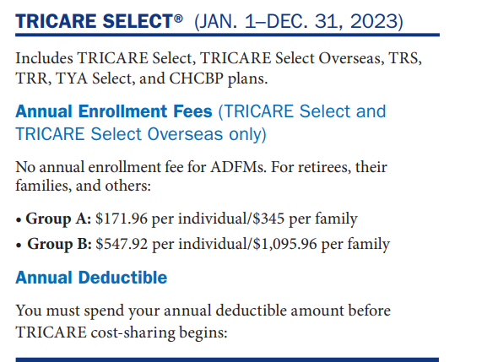

Slide 25
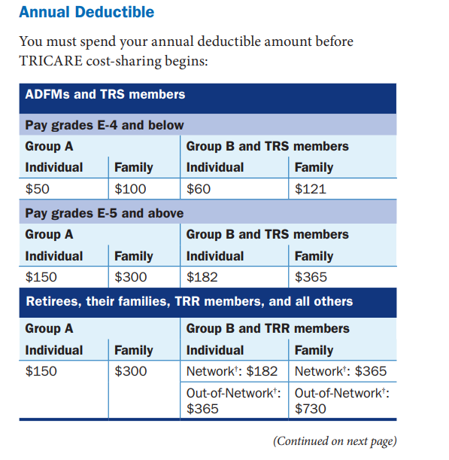

Slide 26
TRICARE Select: Getting Care
Under TRICARE Select:
If you use a network provider:
- You will pay a fixed fee for care: called a co-pay
- Your out-of-pocket cost well be lower if you use a
network provider
If you use a non-network, TRICARE-authorized
provider:
- You will pay a cost-share / percentage
- You will have a higher deductible and out-of-pocket costs
- You can also invite your provider to become a network provider.

Slide 27
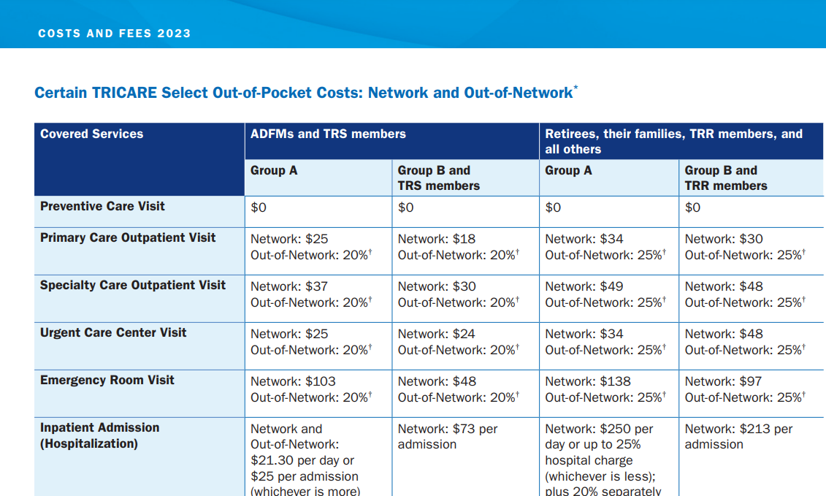

Slide 29
TRICARE Prime
Enroll with a military hospital or clinic (space permitting), TRICARE civilian network provider within a PSA, or US Family Health Plan provider.
Obtain a PCM referral for civilian specialty care (otherwise, higher costs apply).
Military hospitals and clinics have the “right of first refusal” to deliver nonemergency care within the PSA.
If you plan to travel or move:
– Routine care: Receive care before you travel.
– Urgent care: Call your PCM or regional contractor for assistance. – Emergency care: Call 911 or go to the nearest emergency room.
– Seasonal moves: Transfer your enrollment to keep costs low.

Slide 30
www.Tricare.mil/publications
Cost and Fees

Slide 31
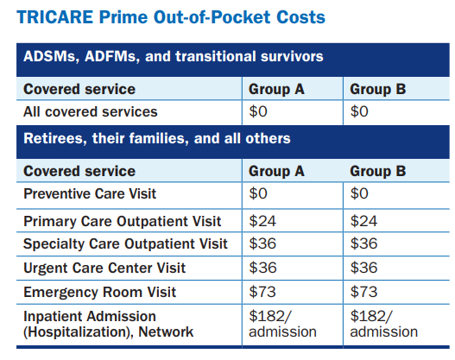

Slide 32
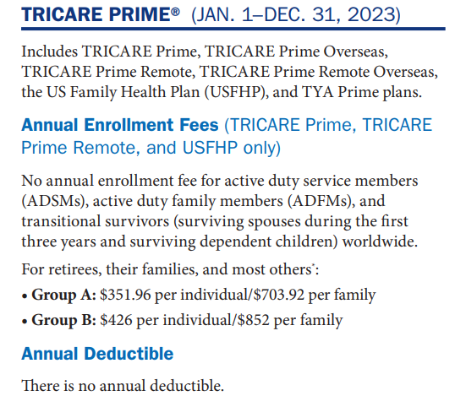

Slide 34
Medical Coverage: US Family Health Plan (USFHP)
www.tricare.mil/usfhp 1.800.748.7374
Locally available locations:
John Hopkins Medicine
Martin’s Point Health Care
Brighton Marine Health Center
Saint Vincent Catholic Medical Centers
Christus Health
Pacific Medical Center [PACMED Clinics]
Enrollment is necessary to be in USFHP
(where locally available)
Notes:
The US Family Health Plan, or USFHP, is a TRICARE Prime option available through networks of community-based not-for-profit health care systems in six areas of the United States.
USFHP is not available to active duty service members.
USFHP provides comprehensive coverage, but it’s important to note that beneficiaries enrolled in USFHP are not eligible for any other TRICARE benefits, including pharmacy, dental, and military hospital or clinic care.
Visit www.usfhp.com to find out if you are in a designated USFHP area or to enroll in USFHP.

Slide 35
TRICARE Overseas Program (TOP)
Select
Freedom to choose providers from a purchased care sector provider in your overseas area. (Different rules apply in the Philippines).
No referrals required.
Yearly deductible and copayments apply.
Enrollment required.
Some services require prior authorization.
Expect to file your own claims.
You may receive medically necessary covered services from a non-network, TRICARE-authorized provider, if a network provider isn’t available.
You will be subject to cost-sharing amounts applicable to out-of-network care.

Slide 36
TRICARE Young Adult
TRICARE Young Adult (TYA) is a premium-based
health care plan available for purchase by qualified young
adult dependents. You may qualify to purchase TYA
coverage if you are all of the following:
– An unmarried dependent of a TRICARE-eligible uniformed service sponsor
– At least age 21 (or age 23 if previously enrolled in
a full-time course of study at an approved institution
of higher learning and if the sponsor provided over
50 percent of the financial support), but have not yet reached
age 26
– Not eligible for an employer-sponsored health plan under your own employment as defined in TYA regulations
– Not otherwise eligible for TRICARE program coverage
For more information, visit www.tricare.mil/tya.

Slide 37
TRICARE Premium Based Plan

Slide 38
TRICARE For Life
TRICARE For Life (TFL) is Medicare-wraparound coverage for TRICARE beneficiaries who are entitled to Medicare Part A and have Medicare Part B, regardless of age or place of residence.
Beneficiaries entitled to Medicare Part A and who have Medicare Part B:
– Are automatically covered under TFL. There are no enrollment forms or enrollment fees.
– Should obtain a new uniformed services ID card at age 65.
– May get care from any Medicare-participating, nonparticipating,
or opt-out provider, or military hospital or clinic if space is available.
For more information on TFL, visit www.tricare.mil/tfl or call 1-866-773-0404.

Slide 39
 | What You Pay
Type of Service | Medicare Pays | TRICARE Pays | You Pay
Covered by TRICARE and Medicare | Medicare-authorized amount | TRICARE-allowable amount | Nothing
Covered by Medicare only (e.g., chiropractic care) | Medicare-authorized amount | Nothing | Medicare annual deductible and cost-share
Covered by TRICARE only (e.g., TRICARE- covered services received overseas) | Nothing | TRICARE-allowable amount | TRICARE annual deductible and cost-share
Not covered by TRICARE or Medicare | Nothing | Nothing | Billed charges (which may exceed the Medicare- or TRICARE-allowable amount)

Slide 40
 | Using TFL Overseas
For overseas locations outside the United States and U.S. territories, TFL works like TRICARE Select and you may visit any host nation provider for care.*
Claims are filed with the TOP claims processor. – For more information, visit www.tricare-overseas.com.
* If you live or travel in the Philippines, you are encouraged to see a preferred provider for care. For more information, visit www.tricare.mil/philippines.

Slide 41
Today’s AGENDA
Preparing for Retirement
TRICARE Program Options
TRICARE Pharmacy Benefit Information
For Information and Assistance

Slide 42
 | Pharmacy Options
Military Pharmacy
Usually inside military hospitals and clinics
Get up to a 90-day supply
TRICARE Pharmacy Home Delivery
Must use this option for some drugs
Get up to a 90-day supply of covered drugs
TRICARE
Retail Network Pharmacy
Fill prescriptions without submitting a claim for covered drugs
Get up to a 30-day supply
Non-Network Pharmacy
Pay full price upfront and, for covered drugs, file a claim to get a portion of your money back
Get up to a 30-day supply

Slide 43
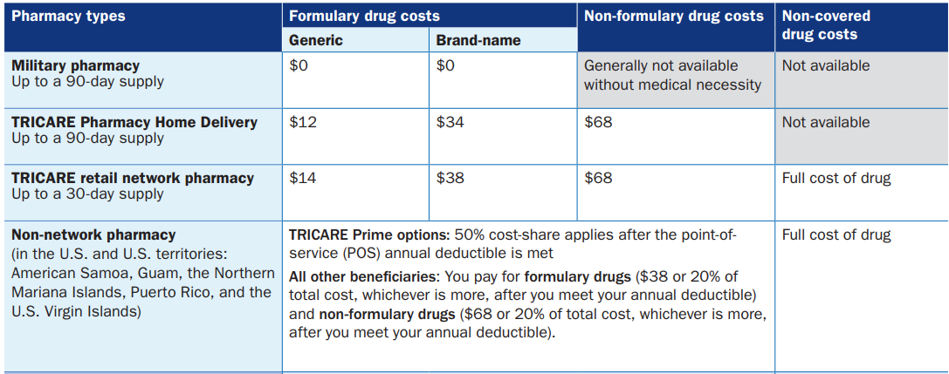

Slide 44
 | Pharmacy Benefits with OHI
OHI is always the primary payer:
– Use OHI first, then submit claims to TRICARE.
You may still use military pharmacies.
You may use TRICARE Pharmacy Home Delivery
or TRICARE retail network pharmacies only if:
– OHI does not cover your prescription
– You have reached your OHI’s benefit cap

Slide 45
Today’s AGENDA
Preparing for Retirement
TRICARE Program Options
TRICARE Other Important Information
For Information and Assistance

Slide 46
TRICARE and Other Health Insurance
Other health insurance (OHI) (includes national health insurance overseas) is considered your primary health insurance.
TRICARE is the last payer to all other health benefits and insurance plans except for Medicaid, TRICARE supplements, the Indian Health Service, and other programs and plans as identified by the Defense Health Agency.
If you have OHI:
– Fill out and submit your regional contractor’s TRICARE Other Health
Insurance Questionnaire at www.tricare.mil/forms.
– Follow your OHI’s rules for prior authorizations and filing
claims.
– Tell your provider about your OHI and TRICARE.
– Show your provider your OHI card.

Slide 47
Explanation of Benefits
An explanation of benefits (or EOB) documents how a claim was settled.
You can receive an EOB statement online on your regional contractor’s website.
– You must register on their secure portal first.
– If overseas, you can still receive a paper EOB.
Statements should be received within six weeks of claims submission.

Slide 48
Today’s AGENDA
Preparing for Retirement
TRICARE Program Options
TRICARE Benefit Information
For Information and Assistance

Slide 49
Looking for More Information? www.tricare.mil
Stateside Regional Contractors TRICARE East Region Humana Military 1-800-444-5445 HumanaMilitary.com www.tricare-east.com TRICARE West Region Health Net Federal Services, LLC 1-844-866-WEST (1-844-866-9378) www.tricare-west.com | Overseas Regional Contractor TRICARE Overseas Program (TOP) International SOS Government Services, Inc. www.tricare-overseas.com/contact-us More Resources TRICARE Website www.tricare.mil
Publications
www.tricare.mil/publications
milConnect
https://milconnect.dmdc.osd.mil

Slide 50
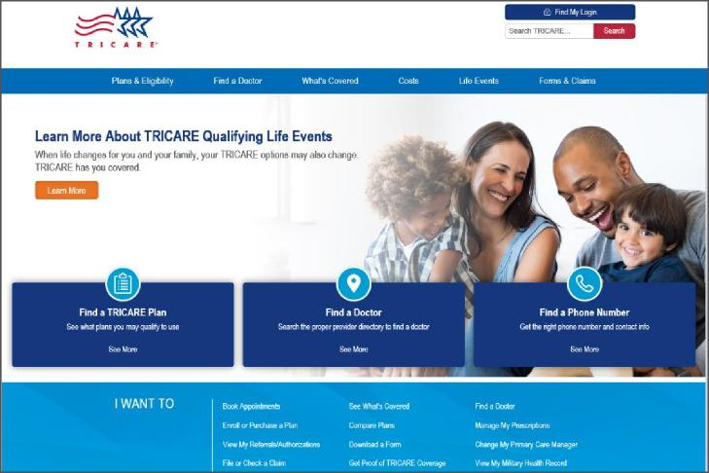
TRICARE.mil
Easily manage benefits at home or on the go via secure websites. On www.tricare.mil, the “I want to ... ” section helps you: Enroll in or purchase a plan File or check a claim View referrals and prior authorizations Find a doctor ... and much more!

Slide 51
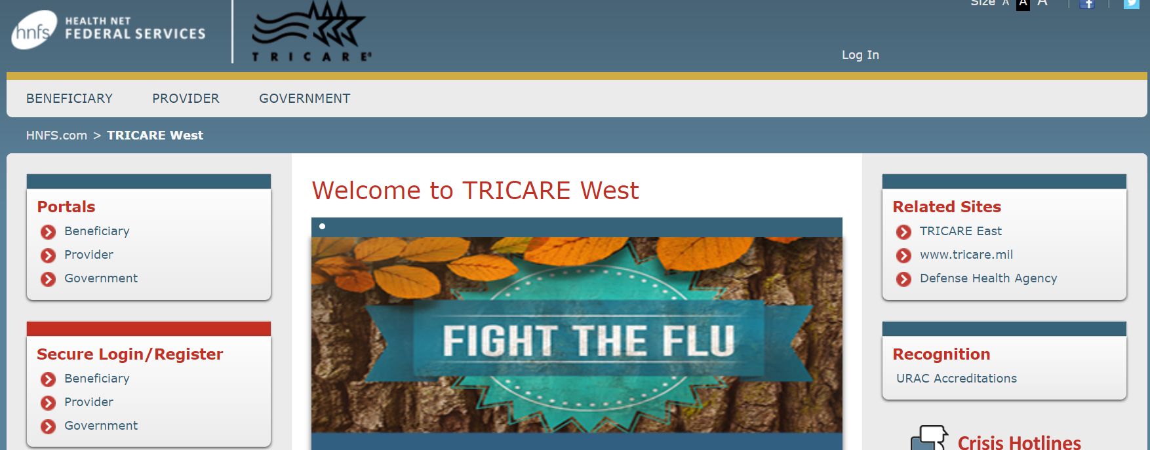
www.Tricare-west.com

Slide 52
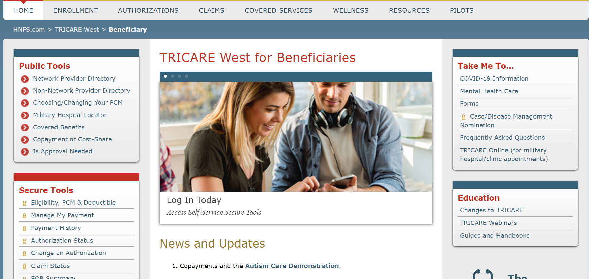
1
3
2
4

Slide 53
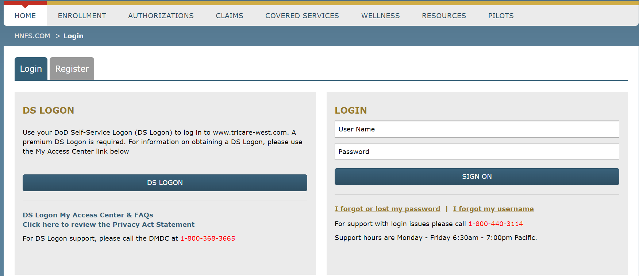

Slide 54
Today’s AGENDA
Preparing for Retirement
TRICARE Program Options
TRICARE Benefit Information
Federal Employee Dental and Vision Program [FEDVIP]
www.benefeds.com/military

Slide 55
 | Federal Employees Dental and
Vision Insurance Program
The U.S. Office of Personnel Management offers eligible TRICARE beneficiaries the option to enroll in a FEDVIP dental plan.
FEDVIP offers a range of plans from a number of dental plans.
FEDVIP is available to:
– Retired service members and their eligible family members
– Certain retired National Guard and Reserve members and their family members
– Certain survivors
– Medal of Honor recipients and their immediate family members or survivors
Former spouses and remarried surviving spouses don’t qualify to purchase dental coverage.
For FEDVIP plans and enrollment information, visit www.benefeds.com.

Slide 56
 | FEDVIP Vision Options
FEDVIP offers vision coverage for eligible TRICARE beneficiaries who are
enrolled in or are using a TRICARE health plan including:
– TRICARE Prime, including USFHP
– TRICARE Select
– TRS
– TRR
– TFL
FEVIP vision coverage is available to:
– Active duty family members
– Retired service members and their eligible family members
– National Guard and Reserve members and eligible family members
Visit www.benefeds.comfor eligibility, carrier, and enrollment information.

