Slide 1


Separating From Active Duty
Your Options For Care After Separating From Active Duty
www.health.mil/tricarebriefings
PP436G011021WW

Slide 2

Today’s AGENDA
Health Care Coverage
Transitional Coverage
Benefit Information
Other Important Information
For Information and Assistance

Slide 3

Today’s AGENDA
Health Care Coverage
Transitional Coverage
Benefit Information
Other Information
For Information and Assistance

Slide 4


Keep DEERS Information Up To Date
Being able to use TRICARE depends on keeping DEERS up to date. Update DEERS after you have a life event, like getting married or divorced, moving, giving birth, adopting a child, retiring, and other changes.
Go to an ID Card Office (https://idco.dmdc.osd.mil/idco)
Note: You must use this option to add family members in DEERS.
Log on to https://milconnect.dmdc.osd.mil.
Call 1-800-538-9552.
Fax 1-800-336-4416.

Slide 5
Terminal Leave
Terminal Leave
Sponsors
Family Members
Get care as an active duty service member (ADSM)
May seek care at any military hospital or clinic, but must remain enrolled in TRICARE Prime at current duty station
May not transfer enrollment
Remain covered by their current program (for example, TRICARE Prime or TRICARE Select)
Can transfer enrollment to another TRICARE Prime or TRICARE Select location

Slide 6


The Affordable Care Act
TRICARE meets the minimum essential coverage requirement under the Affordable Care Act (ACA).
Each tax year, you will get an Internal Revenue Service (IRS) Form 1095 from your pay center. It will list your TRICARE coverage for each month.
Your Social Security number (SSN) and the SSNs of each of your covered family members should be included in DEERS for your TRICARE coverage to be reflected accurately.

Slide 7
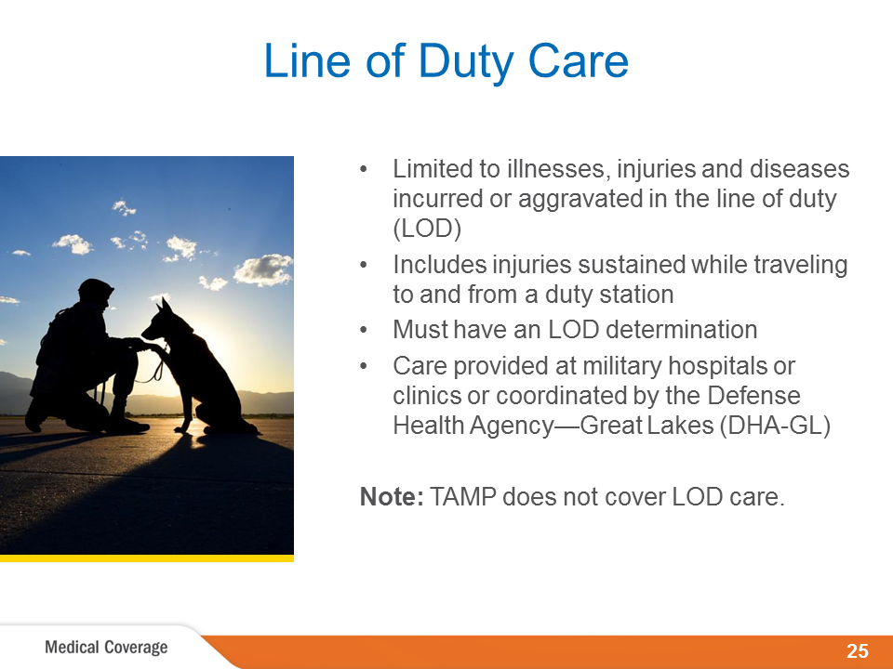
Line of Duty Care
Not a TRICARE Program
Notes:
During inactive duty period, National Guard and Reserve members may also be eligible for line of duty, or LOD, care.
An LOD injury, illness or disease is determined to have been incurred or aggravated in the LOD, including injuries sustained while traveling to and from a duty station while on inactive duty for training or active duty orders for a period of 30 days or less.
Your command unit must issue an LOD determination for you to get care. Because you won’t otherwise appear as TRICARE-eligible in DEERS, your unit/command medical representative must provide the LOD documentation to the Defense Health Agency—Great Lakes, or DHA-GL, before you seek care.
Most LOD care is delivered through military hospitals and clinics. If there is not a military hospital or clinic nearby, your unit/command medical representative will work closely with the DHA-GL to coordinate your care.
For more information, contact your command unit. All requests for LOD care must be coordinated through and initiated by your unit.
Note: TAMP does not cover LOD care. When getting LOD care, provide eligibility documentation when you get service to avoid incurring costs associated with other TRICARE coverage.

Slide 8
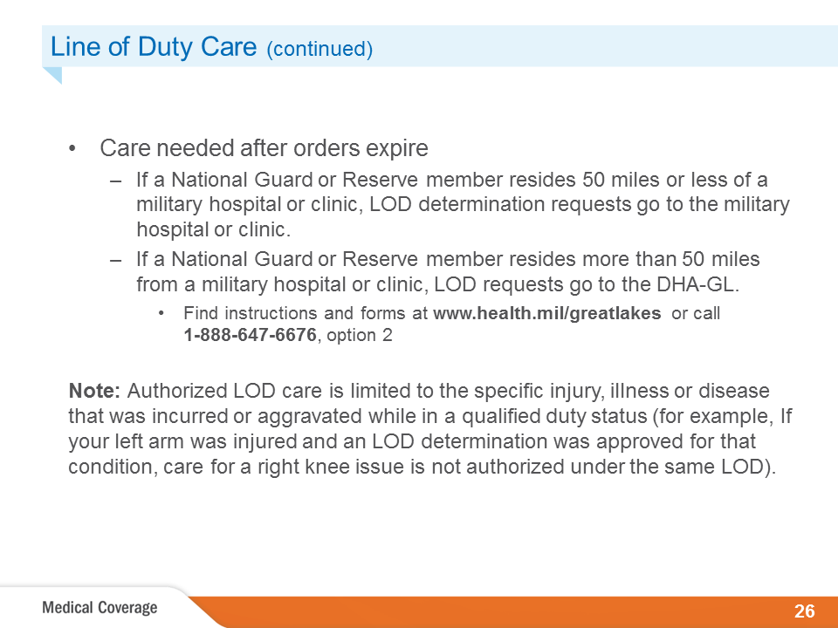
Line of Duty Care continued
Notes:
If further medical care is needed relating to an injury, illness or disease that was incurred or aggravated while in a qualified duty status and after orders expire, an LOD determination must be initiated by your command unit.
If you need care during the LOD review and investigation, it can be preauthorized by the military hospital or clinic (for National Guard and Reserve members residing 50 miles or less of a military hospital or clinic) or by DHA-GL (for National Guard and Reserve members residing more than 50 miles from a military hospital or clinic).
An LOD condition requiring care must be incurred or aggravated while in a qualified duty status (performing military service).
Medical conditions not incurred or aggravated while in a qualified duty status are not authorized for treatment and claims payment under LOD.
Clinical documentation of the condition must accompany the LOD form and preauthorization requests.
If you are remote, DHA-GL uses the DHA-GL Worksheet-02 for general medical care and DHA-GL Worksheet-06 for surgical care as the preauthorization request forms.
Visit www.health.mil/greatlakes for the worksheets or call 1-888-647-6676, and choose option 2.
Army National Guard and Reserve members should submit LOD documentation through eMMPS (LOD module).
Other National Guard and Reserve members should fax LOD documentation to DHA-GL at
1-847-688-7394.

Slide 9
Today’s AGENDA
Health Care Coverage
Transitional Coverage
Benefit Information
Other Information
For Information and Assistance

Slide 10

Coverage Options
Transitional health care options: – Transitional Assistance Management Program (TAMP) – Continued Health Care Benefit Program (CHCBP) If you’re transitioning to the National Guard or Reserve, you may qualify to purchase TRICARE Reserve Select (TRS). For more information, go to www.tricare.mil/trs. Active duty coverage ends on your last day of active duty.

Slide 11
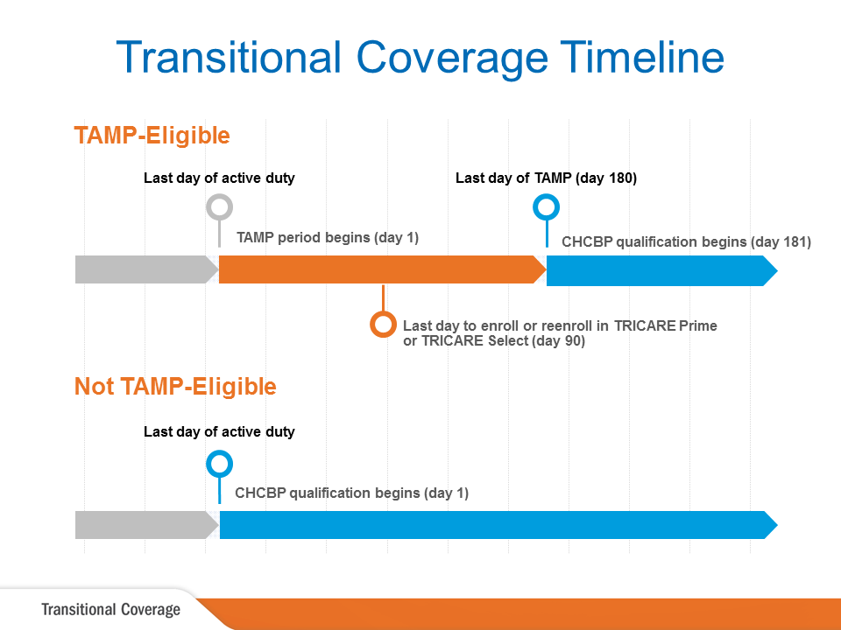
Transitional Coverage Timeline
TRICARE Reserve Select
TRICARE Reserve Select.
Notes:
This slide shows the timeline for transitional health care benefits.
If eligible, the 180-day TAMP period begins the day after you separate from active duty.
For continuous TRICARE Prime or TRICARE Select coverage during TAMP, you may elect to enroll or re-enroll in TRICARE Prime or Select within 90 days of your eligibility for TAMP.
CHCBP qualification begins the day after you separate from active duty, or, if applicable, the day after your TAMP period ends.
Remember, enrollment in CHCBP must occur within 60 days of losing regular TRICARE eligibility or TAMP coverage, whichever is later.

Slide 12
Coverage Options
Transitional health care options: – Transitional Assistance Management Program (TAMP) – Continued Health Care Benefit Program (CHCBP) If you’re transitioning to the National Guard or Reserve, you may qualify to purchase TRICARE Reserve Select (TRS). For more information, go to www.tricare.mil/trs. Active duty coverage ends on your last day of active duty.

Slide 13
TAMP Overview
180 days of transitional health care
benefits
Begins the day after you
separate from active duty
You have 90 days from the start of
TAMP to enroll or reenroll in a
TRICARE plan.
All beneficiaries covered as
active duty family members (ADFMs),
including the sponsor

Slide 14
TAMP Eligibility
You and your eligible family members may get TAMP health care
benefits after active duty if you:
– Involuntarily separate from active duty under honorable conditions. This includes service members who receive a voluntary separation incentive
or voluntary separation pay and aren’t entitled to retirement pay.
– Are a National Guard or Reserve member separating from a period of active duty that was more than 30 consecutive days in support of a contingency operation
– Separate following involuntary retention (stop-loss) in support of a contingency operation
– Separate following a voluntary agreement to stay on active duty for less than one year in support of a contingency operation
– Separate and agree to immediately become a member of the Selected Reserve with no gap in service
– Separate due to a sole-survivorship discharge

Slide 15
Program Options
Program Options
TRICARE Prime® | TRICARE Select®
Available in Prime Service Areas (PSAs) | Available anywhere
Enrollment required | Enrollment required
Get most care from a PCM | Freedom to choose your provider Network = lower costs Non-network = higher costs
Need a PCM referral for care your PCM can’t provide to avoid additional charges | Referrals not necessary; prior authorization from your regional contractor may be required
No deductibles or cost-shares | Deductible, copayments and cost-shares apply

Slide 16
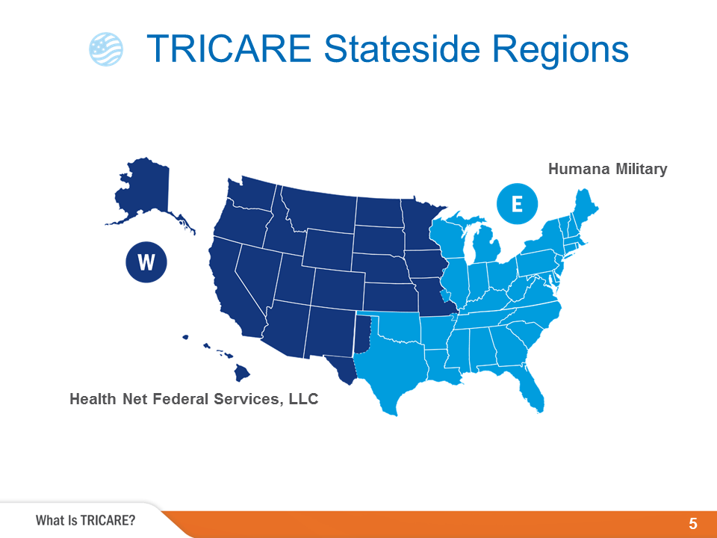
TRICARE Stateside Regions
East Region
Humana Military
1.800.444.5445
HumanaMilitary.com
www.tricare-east.com
West Region
Health Net Federal Services
1.844.866.9378
www.tricare-west.com
For more information about NDAA impact on TRICARE visit: www.tricare.mil/changes
Notes:
TRICARE is available worldwide and managed regionally. There are two TRICARE regions in the United States—TRICARE East and TRICARE West—and one overseas region with three areas—TRICARE Eurasia-Africa, TRICARE Latin America and Canada, and TRICARE Pacific. Benefits are the same regardless of where you live, but there are different customer service contacts for each region.
Health Net Federal Services, LLC administers the benefit in the West Region and Humana Military administers the benefit in the East Region. Both regional contractors partner with the Military Health System to provide health, medical, and administrative support including customer service, claims processing, and prior authorizations for certain health care services.
Contact information for each region will be provided at the end of this presentation.

Slide 17
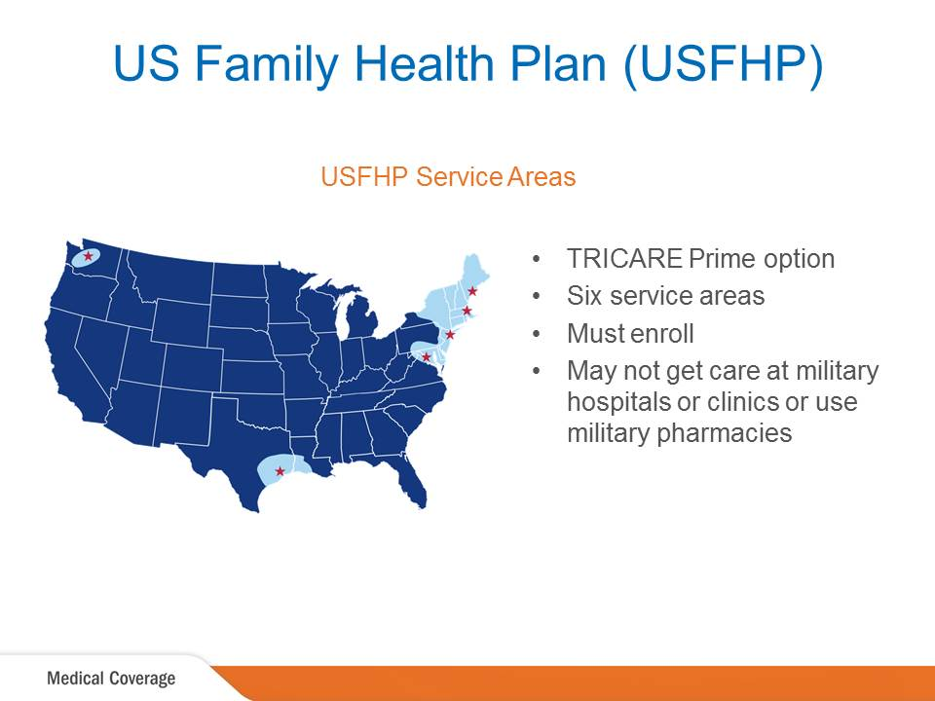
Medical Coverage: US Family Health Plan (USFHP)
www.tricare.mil/usfhp 1.800.748.7374
Locally available locations:
John Hopkins Medicine
Martin’s Point Health Care
Brighton Marine Health Center
Saint Vincent Catholic Medical Centers
Christus Health
Pacific Medical Center [PACMED Clinics]
Enrollment is necessary to be in USFHP
(where locally available)
Notes:
The US Family Health Plan, or USFHP, is a TRICARE Prime option available through networks of community-based not-for-profit health care systems in six areas of the United States.
USFHP is not available to active duty service members.
USFHP provides comprehensive coverage, but it’s important to note that beneficiaries enrolled in USFHP are not eligible for any other TRICARE benefits, including pharmacy, dental, and military hospital or clinic care.
Visit www.usfhp.com to find out if you are in a designated USFHP area or to enroll in USFHP.

Slide 18
Coverage Options
Transitional health care options: – Transitional Assistance Management Program (TAMP) – Continued Health Care Benefit Program (CHCBP) If you’re transitioning to the National Guard or Reserve, you may qualify to purchase TRICARE Reserve Select (TRS). For more information, go to www.tricare.mil/trs. Active duty coverage ends on your last day of active duty.

Slide 19

Continued Health Care Benefit Program
Not a TRICARE Program
Premium-based, continued health care coverage
Available for 18-36 months after you lose all TRICARE eligibility
Similar to TRICARE Select, but with premium payments
No dental benefits
Requires enrollment within 60 days after loss of regular TRICARE eligibility or TAMP coverage

Slide 20

Qualifying for CHCBP
Former ADSMs and their qualifying family members (up to 18 months) Former National Guard and Reserve members (up to 18 months) Certain former spouses who haven’t remarried before age 55 (up to 36 months) Dependent spouses and children (up to 36 months)

Slide 21
Purchasing CHCBP
Purchase CHCBP coverage within 60 days of loss of regular TRICARE eligibility or TAMP coverage.
Fill out the Continued Health Care Benefit Program (CHCBP) Application (DD Form 2837):
– Download the form at HumanaMilitary.com.
– Call Humana Military at 1-800-444-5445.
Provide a 90-day premium payment:
– Go to www.tricare.mil/costsfor information on costs.

Slide 22
Today’s AGENDA
Health Care Coverage
Transitional Coverage
Benefit Information
Other Information
For Information and Assistance

Slide 23
Coverage Options
Transitional health care options: – Transitional Assistance Management Program (TAMP) – Continued Health Care Benefit Program (CHCBP) If you’re transitioning to the National Guard or Reserve, you may qualify to purchase TRICARE Reserve Select (TRS). For more information, go to www.tricare.mil/trs. Active duty coverage ends on your last day of active duty.

Slide 24
Transitional Coverage Timeline
TRICARE Reserve Select
TRICARE Reserve Select [TRS]
Notes:
This slide shows the timeline for transitional health care benefits.
If eligible, the 180-day TAMP period begins the day after you separate from active duty.
For continuous TRICARE Prime or TRICARE Select coverage during TAMP, you may elect to enroll or re-enroll in TRICARE Prime or Select within 90 days of your eligibility for TAMP.
CHCBP qualification begins the day after you separate from active duty, or, if applicable, the day after your TAMP period ends.
Remember, enrollment in CHCBP must occur within 60 days of losing regular TRICARE eligibility or TAMP coverage, whichever is later.

Slide 25
Step 1—Qualify TRICARE Reserve Select
Selected Reserve members may qualify for TRS if they are:
– Not eligible for or enrolled in the Federal Employees Health Benefits (FEHB) Program under sponsor’s own employment
– For more information, visit www.tricare.mil.

Slide 26
Step 2—Purchase TRICARE Reserve Select
Purchase TRS:
Online by using the Beneficiary Web Enrollment (BWE) website at https://milconnect.dmdc.osd.mil.
By mailing a completed and signed Reserve Component Health Coverage Request Form (DD Form 2896-1) to your regional contractor
– Include initial premium payment
By calling your regional contractor
In person overseas at a TRICARE Service Center
For continuous coverage, purchase TRS up to 90 days before TAMP ends, but no later than 90 days after TAMP ends.

Slide 27

TRICARE Reserve Select:
Getting Care
TRS coverage follows the rules of TRICARE Select.
No referrals necessary:
– Certain services require pre- authorization.
– In an emergency, call 911 or go to
the nearest emergency room.
Like TRICARE Select, locate a network or TRICARE-authorized provider.
For space-available care, locate a military hospital or clinic at www.tricare.mil/mtf.

Slide 28

TRICARE Reserve Select: Getting Care (continued)
For TRS, locate a network or non-network TRICARE-authorized
provider:
– Go to www.tricare.mil/findaprovider or call your regional contractor.
– Ask your provider’s office if they accept TRICARE.
If not, invite the provider to become TRICARE-authorized.
Give your regional contractor’s phone number to the provider or send him or her to www.tricare.mil/providers.

Slide 29
Beneficiary Categories:
Group A and Group B
All beneficiaries fall into one of two categories (Group A or Group B) based on when you or your sponsor entered the uniformed services.
  Group A: If your or your sponsor’s initial enlistment or appointment occurred before Jan 1, 2018, you are in Group A.
  Group B: If your or your sponsor’s initial enlistment or appointment occurred on or after Jan 1, 2018, your are in Group B
However, when enrolled in TRS everyone follows Group B cost-shares, deductibles, and catastrophic caps.

Slide 30
TRICARE Reserve Select: Costs
Monthly premiums (per calendar year):
– Go to www.tricare.mil/costs.
    Annual deductible is based on sponsor’s pay grade.
Cost-shares apply for covered services and vary depending on the type of provider (network or non-network).
The catastrophic cap is per family for covered medical services.
For the most up-to-date cost information, visit www.tricare.mil/costs.

Slide 31
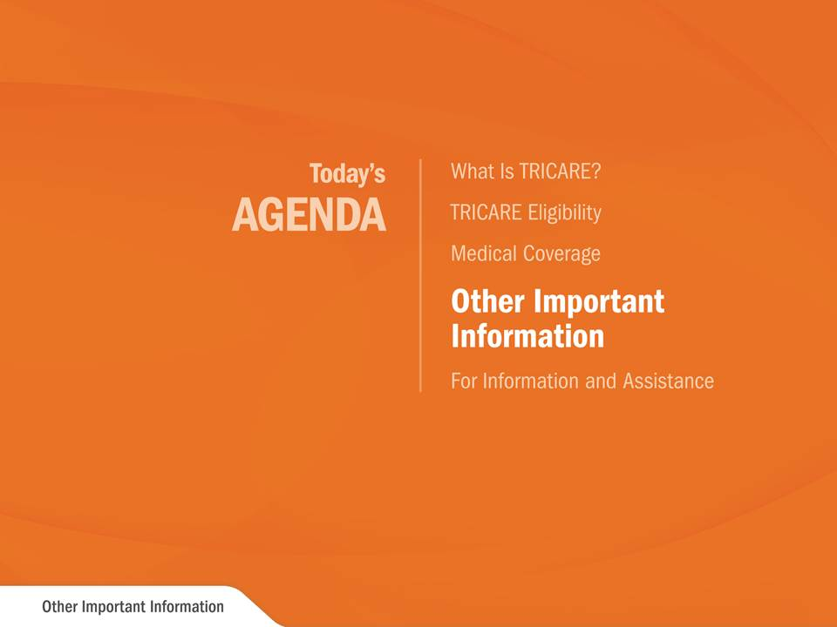
Today’s Agenda: Other Important Information
TRICARE Pharmacy
Notes:
Optional Presenter Comment: We will now discuss other important information.

Slide 32
Transitional Coverage Timeline
TRICARE Reserve Select
TRICARE Reserve Select [TRS]
Notes:
This slide shows the timeline for transitional health care benefits.
If eligible, the 180-day TAMP period begins the day after you separate from active duty.
For continuous TRICARE Prime or TRICARE Select coverage during TAMP, you may elect to enroll or re-enroll in TRICARE Prime or Select within 90 days of your eligibility for TAMP.
CHCBP qualification begins the day after you separate from active duty, or, if applicable, the day after your TAMP period ends.
Remember, enrollment in CHCBP must occur within 60 days of losing regular TRICARE eligibility or TAMP coverage, whichever is later.

Slide 33


 | Pharmacy Options
Military Pharmacy
Usually inside military hospitals and clinics
Get up to a 90-day supply
TRICARE Pharmacy Home Delivery
Must use this option for some drugs
Get up to a 90-day supply
TRICARE
Retail Network Pharmacy
Fill prescriptions without submitting a claim
Get up to a 30-day supply
Pay full price up front and file a claim to get a portion of your money back
Get up to a 30-day supply
Non-Network Pharmacy

Slide 34

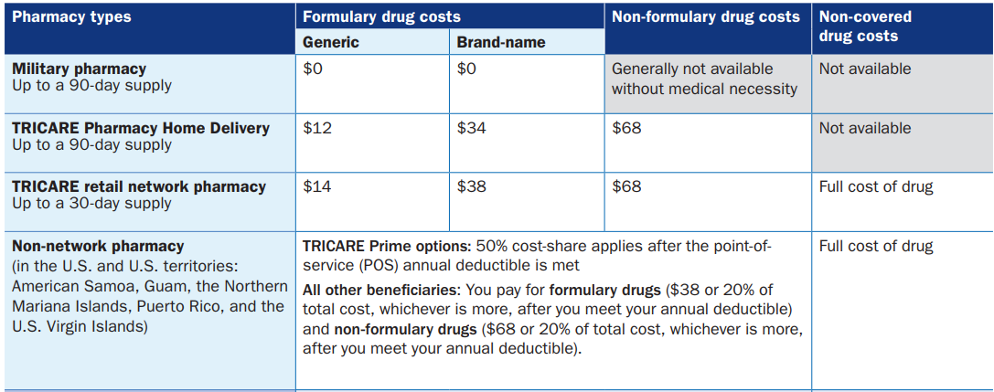

Slide 35
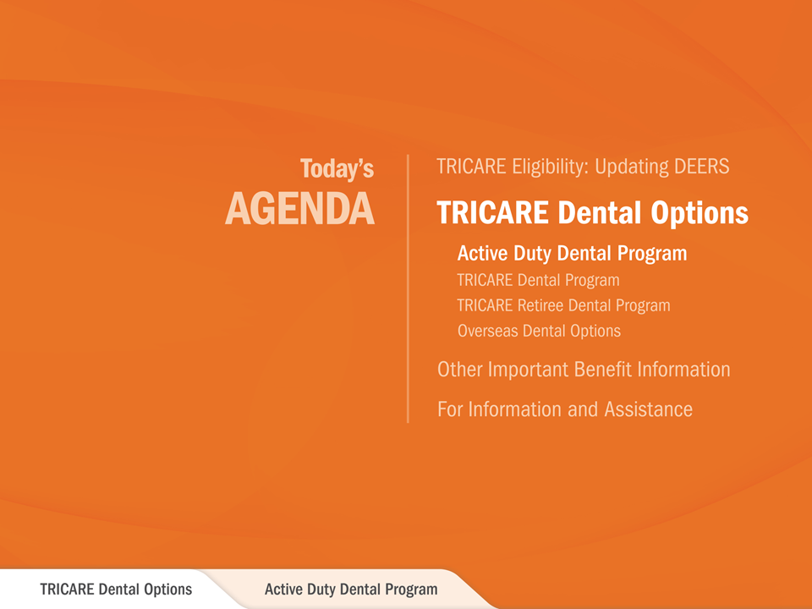
TRICARE Dental Options: Active Duty Dental Program
Notes:
Optional Presenter Comment: Now we will discuss the Active Duty Dental Program.

Slide 36
Transitional Coverage Timeline
TRICARE Reserve Select
TRICARE Reserve Select [TRS]
Notes:
This slide shows the timeline for transitional health care benefits.
If eligible, the 180-day TAMP period begins the day after you separate from active duty.
For continuous TRICARE Prime or TRICARE Select coverage during TAMP, you may elect to enroll or re-enroll in TRICARE Prime or Select within 90 days of your eligibility for TAMP.
CHCBP qualification begins the day after you separate from active duty, or, if applicable, the day after your TAMP period ends.
Remember, enrollment in CHCBP must occur within 60 days of losing regular TRICARE eligibility or TAMP coverage, whichever is later.

Slide 37


 | Active Duty Dental Program
Most active duty service members (ADSMs) must receive dental care from their military dental clinic, also known as a military
Dental Treatment Facility [DTF].
Civilian dental care is available to eligible ADSMs through the Active Duty Dental Program (ADDP), administered by United Concordia Companies, Inc. (United Concordia).
ADDP is available worldwide in two service areas:
– CONUS (Continental United States) 866-984-ADDP/866-984-2337
For more information, visit the United Concordia website at
www.addp-ucci.com.

Slide 38

CONUS: Getting Care With ADDP
CONUS locations: You must use a United Concordia network dentist to receive ADDP-covered dental care. You must have an Appointment Control Number (ACN) before getting nonemergency dental care. – You can schedule dental care after you get an ACN. – For specialty or other dental care, you need an authorization from your civilian dentist before scheduling care. – If you need emergency dental care, you don’t need an authorization or ACN. For a list of covered services, visit: www.addp-ucci.com.

Slide 39
OCONUS: Getting Care With ADDP
OCONUS locations:
– Remote ADSMs must be enrolled in TRICARE Prime Remote Overseas
You can see any dentist.
You must have an Appointment Control Number (ACN) before getting nonemergency dental care.
– You can schedule dental care after you get an ACN.
– For specialty or other dental care, you need an authorization from your civilian dentist before scheduling care.
– If you need emergency dental care, you don’t need an authorization or ACN.
For a list of covered services, visit
www.addp-ucci.com.

Slide 40

TRICARE Dental Options: TRICARE Dental Program
ADFM
Notes:
Optional Presenter Comment: Now we will discuss the TRICARE Dental Program.

Slide 41


 | TRICARE Dental Program (TDP)
A voluntary, premium-based Department of Defense dental program. The benefit is administered by United Concordia.
Available to eligible:
– Active duty family members
– Selected Reserve and Individual Ready Reserve members (who are not on active duty orders) and their families
– Transitional survivors
– Surviving family members
Provided in both CONUS and OCONUS service areas
Phone: 1-844-653-4061
On Line: visit https://milConnect.dmdc.osd,mil

Slide 42
Transitional Coverage Timeline
TRICARE Reserve Select
TRICARE Reserve Select [TRS]
Notes:
This slide shows the timeline for transitional health care benefits.
If eligible, the 180-day TAMP period begins the day after you separate from active duty.
For continuous TRICARE Prime or TRICARE Select coverage during TAMP, you may elect to enroll or re-enroll in TRICARE Prime or Select within 90 days of your eligibility for TAMP.
CHCBP qualification begins the day after you separate from active duty, or, if applicable, the day after your TAMP period ends.
Remember, enrollment in CHCBP must occur within 60 days of losing regular TRICARE eligibility or TAMP coverage, whichever is later.

Slide 43
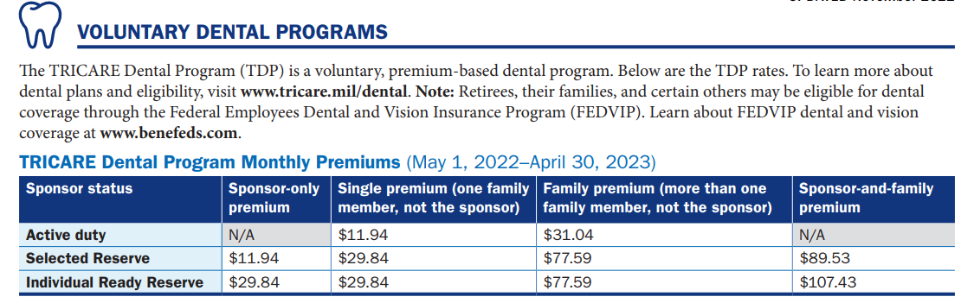

Slide 44

 | TDP Covered Services and Cost-Shares
Type of Service | CONUS |  | OCONUS
 | E1–E4 | Other Pay Grades | Command-sponsored
Diagnostic | 0% | 0% | 0%
Preventive (except sealants) | 0% | 0% | 0%
Sealants (through age 18) | 0% | 0% | 0%
Basic Restorative (fillings) | 20% | 20% | 0%
Endodontic (root canals) | 30% | 40% | 0%
Periodontic (gum treatment) | 30% | 40% | 0%
Oral Surgery (wisdom teeth) | 30% | 40% | 0%
Prosthodontic (dentures/crowns) | 50% | 50% | 50%
Implant Services | 50% | 50% | 50%
Orthodontic | 50% | 50% | 50%
Annual maximum: $1,500/enrollee
Orthodontic
lifetime maximum: $1,750/enrollee
Accidental annual maximum: $1,200/enrollee
For details on TDP covered services, visit the United Concordia TDP website: www.uccitdp.com.

Slide 45
Today’s AGENDA
Health Care Coverage
Transitional Coverage
Benefit Information
Other Information
For Information and Assistance

Slide 46

TRICARE and Medicare
TRICARE For Life is Medicare-wraparound coverage for TRICARE beneficiaries who have Medicare Part A and Part B, regardless of age or where you live.
You are not required to have Medicare Part B if you are an ADSM, ADFM or enrolled in TYA, TRS, TRR or USFHP.
If you don’t sign up for Medicare Part B when
you are first eligible, you may only be able to enroll during the Medicare general enrollment period.
If you sign up for Medicare Part B after your initial enrollment period, you may have to pay a monthly premium surcharge.

Slide 47
TRICARE and
Other Health Insurance
Other health insurance (OHI) is considered your primary
health insurance.
For services covered by Medicare, OHI and TFL, Medicare
pays first, your OHI pays second and TRICARE pays last.
After your OHI pays, TRICARE will pay the lesser of: – The billed amount, minus the payment from your OHI – The amount TRICARE would have paid without OHI – The OHI copayment or deductible
If you have OHI:
– Fill out a TRICARE Other Health Insurance Questionnaire: www.tricare.mil/forms.
– Follow the referral and authorization rules for your OHI. – Tell your provider about your OHI and TRICARE.

Slide 48
Today’s AGENDA
Health Care Coverage
Transitional Coverage
Benefit Information
Other Information
For Information and Assistance

Slide 49

Stateside Regional Contractors TRICARE East Region Humana Military 1-800-444-5445 HumanaMilitary.com www.tricare-east.com TRICARE West Region Health Net Federal Services, LLC 1-844-866-WEST (1-844-866-9378) www.tricare-west.com | Overseas Regional Contractor TRICARE Overseas Program (TOP) International SOS Government Services, Inc. www.tricare-overseas.com/contact-us More Resources TRICARE Website www.tricare.mil
Publications
www.tricare.mil/publications
milConnect
https:///miltconnect.tricare.mil

