Slide 1
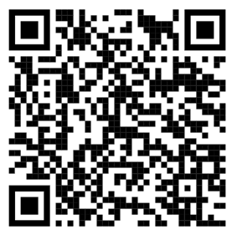
Managing Your (MY) Transition
participant GUIDE (PG)
Use the QR code on the right or the URL below to go to: https://www.tapevents.mil/Assets/ResourceContent/TAP/Managing_Your_Transition.pdf
Download and save the PG on your computer or email it to yourself if using a government computer
NOTE: The corresponding page of the PG will appear in
the left, bottom corner of each slide.
PG, p. 19

Slide 2
2023 TAP CURRICULUM
MANAGING YOUR (MY) TRANSITION

Slide 3
DISCLAIMER
The information provided herein does not constitute a formal endorsement of any company, its products, or services by the U.S. Department of Defense (DoD). Specifically, the appearance or use of external hyperlinks does not constitute endorsement by the DoD of the linked websites or the information, products, or services contained therein. The DoD does not exercise any editorial control over the information you may find at these locations. While this information provides informational resource material to assist military personnel and their families in identifying or exploring resources and options, the resources provided are not exhaustive.
All websites and URLs in this guide were active at the date of publication. However, web content is subject to change without notice. Users of this guide are advised to confirm information is current.
PG, p. 1

Slide 5
THE IMPORTANCE OF TAP
.5%
17%
7%
*Statistics provided by the U.S. Census Bureau
of the U.S. adult population is serving on active duty.
of the U.S. population were veterans in 1990.
of the U.S. population were veterans in 2020.
PG, p. 2

Slide 6
TRANSITON OVERVIEW
You are here
Individualized Initial Counseling (IC)
Pre-Separation Counseling
Managing Your (MY) Transition
NLT 365 days
DoD Transition Day
DOL Employment Fundamentals of Career Transition
VA Benefits and Services
Financial Planning for Transition
MOC Crosswalk
2-Day Tracks
Continuum of Service
Capstone
Employment
Vocational
Education
Entrepreneurship
NLT 90 Days
PG, p. 3

Slide 7
CAREER
READINESS
STANDARDS
Completed | CRS | Course/Brief
 | Start a personal self-assessment/ Individual Transition Plan (ITP). | IC/Pre-Separation Counseling
 | Complete a Gap Analysis or provide verification of employment. | MOC Crosswalk
 | Prepare a criterion-based, post-separation financial plan. | Financial Planning for Transition
 | Register on VA.gov. | VA Benefits and Services
 | Complete a resume or provide verification of employment. | DOL Employment Workshop
 | Complete a comparison of higher education or technical training institution options. | DoD Managing Your Education/DOL Career Credential Exploration
 | Complete a continuum of Military Service Opportunity counseling (Active-component only). | Varies by Installation
√
PG, p. 3

Slide 8
MY transition timeline
www.DoDTAP.mil Located in Transition Services
PG, p. 6

Slide 9
Transition Concerns
MANAGING YOUR TRANSITION
Finding New Purpose and Identity
COURSE OVERVIEW
Managing Transition Stress
Military vs. Civilian Culture
Value of Mentors
Available Resources
PG, p. 7

Slide 10
WHAT ARE YOUR
TRANSITION CONCERNS?
PG, p. 7

Slide 11
TRANSITION CONCERNS
Feeling a Loss of Purpose/Identity
Not Receiving a Guaranteed Paycheck
Getting/Keeping the Right Job
Going into Debt
Obtaining and Paying for Health Care
Losing the Military Support System
PG, p. 8

Slide 12
LOSS OF PURPOSE AND IDENTITY
“The biggest issue Service members encounter when they get out is losing the comradery that comes with being in the military. They lose that brother-/sister-in-arms family connection. The second biggest issue is losing their sense of purpose. When you’re in the military, you have a common mission that’s shared with your brothers and sisters, and when you get out, that purpose and the identity you carved out during your time in the Service is gone.”
_Medically Discharged NCO
PG, p. 10

Slide 13
FINDING NEW PURPOSE AND IDENTITY
Self-reflect and research to find a new purpose
Seek meaningful employment
Join veteran- and military-related groups
Find a cause where you can use your skills in your community
PG, p. 10

Slide 14
RESILIENCY IN TRANSITION
“…The process of adapting well in
the face of change, adversity, or
significant sources of stress”
(Source: American Psychological Association)
TOP RESILIENCY TIPS:
Be Realistic
Turn Challenges into Opportunities
Learn from Adversity
PG, p. 11

Slide 15
MANAGING TRANSITION STRESS
(Some) Symptoms of Stress:
Isolation/Apathy
Irritability/Exhaustion
Headaches/Depression
Decreased Communication
Changes in Appetite or Sleep
Increased Use of Alcohol or Drugs
Feelings of Anxiety or Helplessness
PG, p. 12

Slide 16
RELIEVING STRESS
Communicate
Ask for Help
Exercise
Eat Well and Drink Water
Breathe or Meditate
Fun with Family and Friends
BE FLEXIBLE!
PG, p. 12

Slide 17
WHAT ARE SOME differences
between MILITARY and CIVILIAN
CULTUREs?
PG, p. 13

Slide 18
MILITARY and CIVILIAN
CULTURE DIFFERENCES
Personal Choice
Attire
Pay
Work/Life Balance
Housing
Starting Over
Service to Country
We vs. I
Peer Interaction
Mission/Purpose
Rank/Respect
Language
PG, p. 14

Slide 19
TRANSITION MENTOR
Guide
Counselor
Teacher
Mentor
Consultant
Advisor
Coach
Instructor
PG, p. 17

Slide 20
MENTOR CHARACTERISTICS
Assist in setting goals
Available as a resource and sounding board
Give constructive feedback
Supportive and encouraging
Successful and respected in their fields
PG, p. 17

Slide 21
FINDING A MENTOR
Military Network
Social Media (i.e., LinkedIn)
Military and Veteran Service Organizations (MSO/VSO)
Online Mentorship Networks
Professional Networking Events
PG, p. 17

Slide 22
PRE-TRANSITION RESOURCES
PG, p. 19

Slide 23
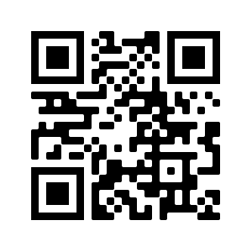
TOL: Transition Online Learning
For online TAP courses, visit TAPevents.mil/courses or scan the QR code
PG, p. 19

Slide 24
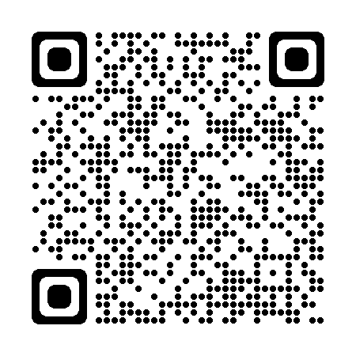
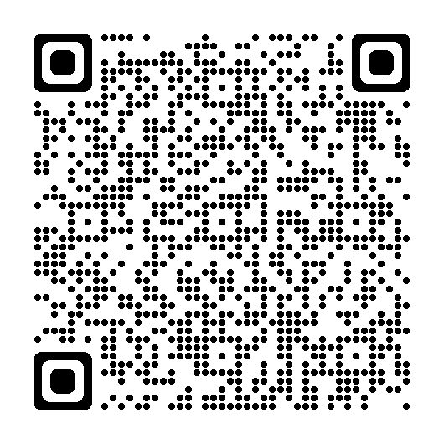
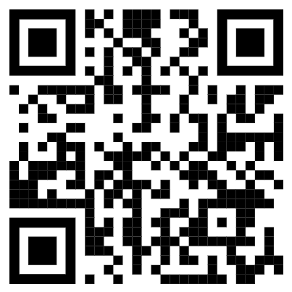
Follow Us on Social Media
Scan the QR codes to stay connected
DoD Transition Assistance
Program
DoD Military-Civilian Transition Office
DoD Military-Civilian Transition Office
PG, p. 19

Slide 25
INSTALLATION RESOURCES
This slide is included for sites to add site-specific
information about Installation Resources.
See font and color details below.
HIDE slide if not used; do not DELETE slide as it may be needed for future presentations.
Title Font: Franklin Gothic Medium, All CAPS. | Body Font: Calibri Body | Size: 18+ Color Codes: Dark Blue - RGB (R: 30, G: 61, B: 88) | Light Blue - RBG (R: 0, G: 176, B: 240)

Slide 26
POST-TRANSITION RESOURCES
PG, p. 21

Slide 27
QUESTIONS?
Reminder:
We are here to help YOU! If you have any questions at any point during your transition, please let us know.

Slide 28
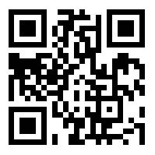
We want your feedback!
Your feedback is anonymous and very valuable to the success of TAP. Every comment is read and addressed as appropriate.
TRANSITION
ASSISTANCE PARTICIPANT ASSESSMENT
Use computer or mobile device
Go to: https://www.dodsurveys.mil/tap
Select Managing Your (MY) Transition
Complete assessment
OR…SCAN THIS QR CODE WITH YOUR PERSONAL DEVICE TO BEGIN THE ASSESSMENT
PG, p. 23

