Slide 1
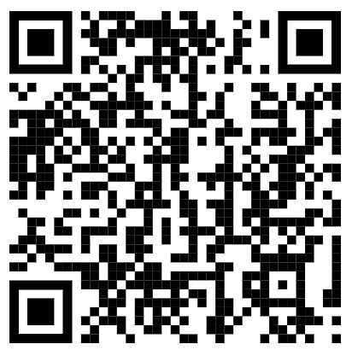
Military occupational code (MOC)
participant GUIDE (PG)
Use the QR code on the right or the URL below to go to:
https://www.tapevents.mil/Assets/ResourceContent/TAP/MOC_Crosswalk.pdf
Download and save the PG on your computer or email it to yourself if using a government computer
NOTE: The corresponding page of the PG will appear in
the left, bottom corner of each slide.
PG, p. 3

Slide 2
2023 TAP CURRICULUM
MILITARY OCCUPATIONAL CODES CROSSWALK

Slide 3
DISCLAIMER
The information provided herein does not constitute a formal endorsement of any company, its products, or services by the U.S. Department of Defense (DoD). Specifically, the appearance or use of external hyperlinks does not constitute endorsement by the DoD of the linked websites or the information, products, or services contained therein. The DoD does not exercise any editorial control over the information you may find at these locations. While this information provides informational resource material to assist military personnel and their families in identifying or exploring resources and options, the resources provided are not exhaustive.
All websites and URLs in this guide were active at the date of publication. However, web content is subject to change without notice. Users of this guide are advised to confirm information is current.
PG, p. 2

Slide 4
TRANSITON OVERVIEW
Individualized Initial Counseling (IC)
Pre-Separation Counseling
Managing Your (MY) Transition
NLT 365 days
DoD Transition Day
You are here
DOL Employment Fundamentals of Career Transition
VA Benefits and Services
Financial Planning for Transition
MOC Crosswalk
2-Day Tracks
Continuum of Service
Capstone
Employment
Vocational
Education
Entrepreneurship
NLT 90 Days
PG, p. 2

Slide 5
MOC CROSSWALK
MOC Crosswalk Process
The Gap Analysis
Finding and Translating Your Skills
COURSE OVERVIEW
Tools of Transition
Civilian Credentialing
Complete a Gap Analysis or
provide verification of
employment
CRS
Identifying Possible Civilian Careers
Influences on Career Selection
PG, p. 3

Slide 6
THE CROSSWALK PROCESS
EXAMINE
MILITARY
EXPERIENCE
IDENTIFY
CIVILIAN
OPPORTUNITIES
IDENTIFY
REQUIREMENTS
DOCUMENT
THE GAP
PG, p. 4

Slide 7
WHERE AM I NOW? Current MOC: _________________ Use VMET, JST, CCAF transcript, ESS-CG, CG-4082, and evaluations to complete this column | WHAT DO I NEED TO FILL IN THE GAP? | WHERE AM I GOING? Civilian Occupation: _________________ Use results from My Next Move for Veterans and O*NET to complete this column.
Experience and skills I have: | Experience and skills I need to obtain: | Experience and skills this occupation requires:
Education and training I have: | Education and training I need to obtain: | Education and training this occupation requires:
Credentials (license, certification, certificate) I have: | Credentials (license, certification, certificate) I need to obtain: | Credentials (license, certification, certificate) or any other requirements for this occupation:
THE GAP ANALYSIS
PG, p. 5

Slide 8
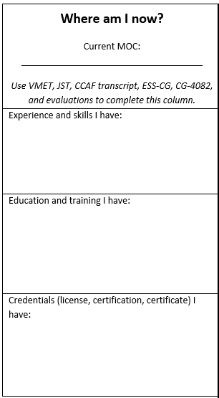
WHERE AM I NOW?
Current MOC
Experience/Skills
Education/Training
Credentials
PG, p. 6

Slide 9
HARD VS. SOFT SKILLS
Hard Skills – specific, teachable knowledge and abilities that can be defined and measured
Examples: software applications, languages, typing, operating machinery
Soft Skills – less defined, interpersonal skills
Examples: leadership, team building, communication, problem solving
PG, p. 6

Slide 10
TRANSLATING YOUR SKILLS
To learn civilian terminology for your field:
Schedule informational interviews in your chosen career field
Find a mentor in your desired field
Follow companies and connect with professionals on LinkedIn
Read publications, blogs and view related videos
AVOID MILITARY JARGON AND ACRONYMS
PG, p. 9

Slide 11
Helps with resume preparation
Translates military terminology and training into civilian terms
Establishes capabilities with prospective employers
Assists in applying to college or vocational institutes
Lists military job experience and training history
Suggests related certification and licensure
Provides civilian equivalent job titles
PURPOSE
OF VMET
PG, p. 10

Slide 12
OCCUPATION: 6317, Aircraft Communications/Navigation/Weapon Systems Technician
PRIMARY OCCUPATION:
MARINE CORPS, ACTIVE: STAFF SERGEANT, Pay Grade E-6 JUL 2017 -JAN 2020 (2 Years 6 Months)
MARINE CORPS, ACTIVE: SERGEANT, Pay Grade E-5 MAR 2015 - JUL 2017 (2 Years 4 Months
OCCUPATION DESCRIPTION FOR: 6317
(MCE-6317-002, Exhibit dates FEB 2001 - JUL 2017)
Installs, removes, inspects, tests, maintains, and repairs components, subsystems, and ancillary equipment on installed aircraft communications, navigation, and deceptive electronic countermeasures systems.
RELATED CIVILIAN OCCUPATIONS FOR: 6317
Avionics Technician (DOT 823.261-026)
Avionics Technicians (ONET 49-2091.00)
Duty and Occupation Code
Occupation Description
VMET:
EXPERIENCE
HISTORY
Related Occupation
PG, p. 11

Slide 13
MILITARY TRAINING: MAR 2017 - APR 2017
NAVY COURSE: A-012-0077, Instructional Delivery Continuum (IDC) - Journeyman Instructor Training (JIT)
LENGTH: 2 weeks (80 hours)
COURSE DESCRIPTION FROM AMERICAN COUNCIL ON EDUCATION:
(NV-1406-0044, Exhibit dates SEP 2007 - SEP 2015)
Upon completion of the course, the student will be able to deliver lectures employing recitation, questioning, self and group-paced methods of instruction, technology aids, and case study techniques. They will also be able to apply some motivational techniques to encourage learning.
Topics include audiovisual materials, discussion, case studies, learner presentations, classroom exercises, computer- based training and lecture, communication techniques, learning objectives, instructional technology, case studies, motivation, self- and group-paced methods of instruction, and questioning techniques.
Training Dates, Course Number, and Length
Course Description
VMET: TRAINING HISTORY
PG, p. 11

Slide 14
EMPLOYEE SUMMARY SHEET (ESS-CG)
Lists all jobs held to include job titles:
Position History
Rank History
Education
TMT History
Direct Access Courses
Training
Tests
Competencies
Board/Memberships
Medals and Awards
PG, p. 12

Slide 15
JOINT
SERVICE
TRANSCRIPT (JST)
PG, p. 12

Slide 16
COMMUNITY
COLLEGE OF THE AIR FORCE (CCAF) TRANSCRIPT
PG, p. 13

Slide 17
RECORD OF PROFESSIONAL DEVELOPMENT (CG-4082)
Identifies academic and military courses and training
Can supplement the JST and be used to boost the education and training sections of the Gap Analysis and a resume
PG, p. 13

Slide 18
CREDENTIALING
License
Certification
Certificate
Some military specialties require a credential
Should be documented on VMET, JST, CCAF transcript, ESS-CG, or CG-4082
PG, p. 13

Slide 19
TYPES OF CREDENTIALS
LICENSE:
Doctor/Nurse
Teacher
Counselor
Plumber
CPA
Analyst
CERTIFICATION:
Lean Six Sigma
PMP
Microsoft
X-Ray Technician
Physical Therapy Aide
CERTIFICATE:
Hospital Transcriptionist
Medical Coder
Travel Agent
Library Technician
PG, p. 14

Slide 20
CREDENTIAL OPPORTUNITIES ONLINE
COOL
Army: https://www.cool.osd.mil/army/
Navy: https://www.cool.navy.mil/usn/
Marine Corps: https://www.cool.navy.mil/usmc/
Air Force: https://www.afvec.us.af.mil/afvec/af-cool/welcome/
Coast Guard: https://www.cool.osd.mil/uscg/
PG, p. 14

Slide 21
MILGEARS
Helps transitioning Service members explore post-service career opportunities
Captures civilian and military education, training, experience, and skills
Identifies credentials to be used in a civilian career
Explores careers related to interests
Identifies gaps between experience and job requirements
Finds careers in high-demand areas
PG, p. 15

Slide 22
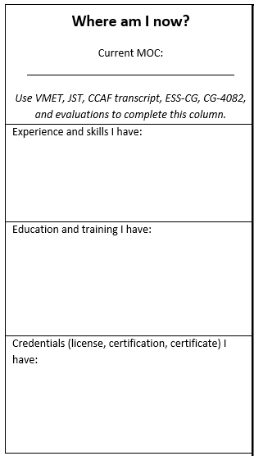
ACTIVITY: GAP ANALYSIS
WHERE AM I NOW?
Use the VMET, JST, CCAF transcript, ESS-CG, CG-4082, and evaluations to find the following information:
Experience and Skills
Education and Training
Credentials (license, certification, certificate)
Complete the Where am I now? section of the Gap Analysis.
PG, p. 16

Slide 23
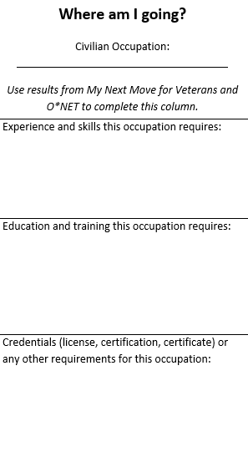
WHERE AM I GOING?
Civilian Occupation
Experience and skills required
Education and training required
Credentials:
License
Certification
Certificate
PG, p. 17

Slide 24
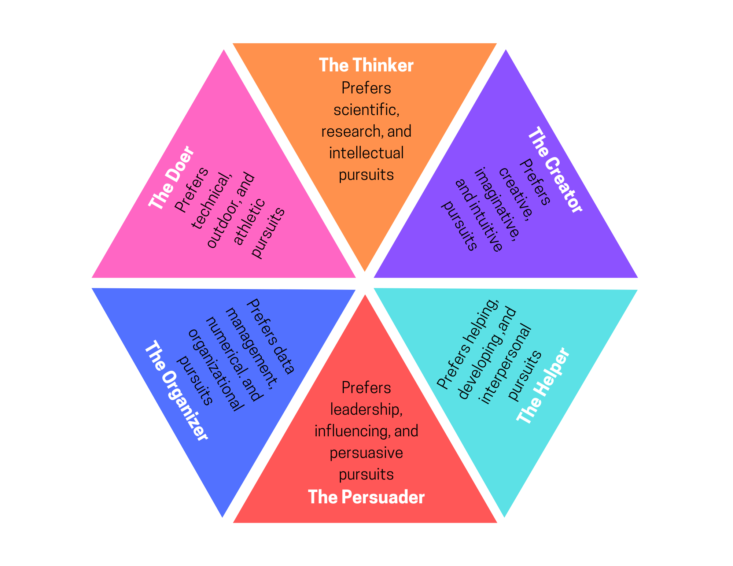
RIASEC MODEL
PG, p. 18

Slide 25
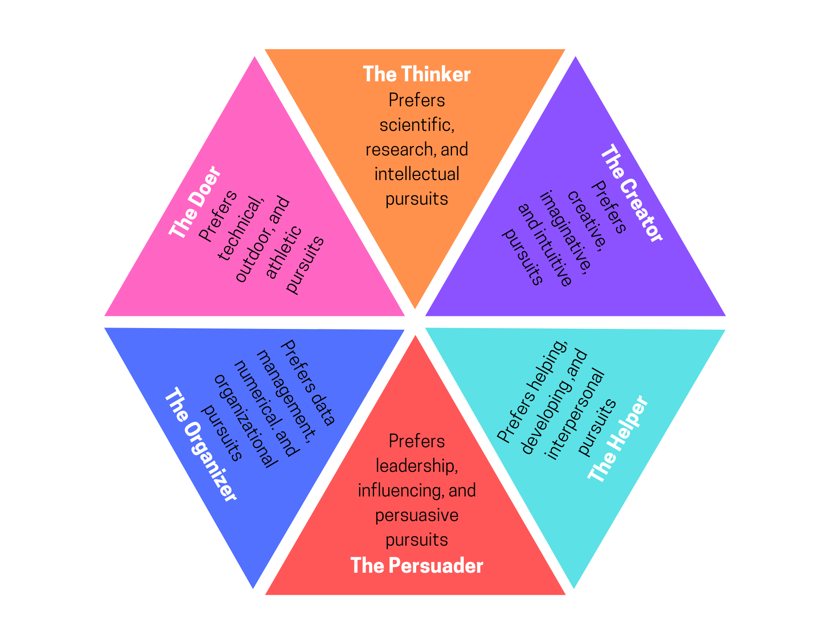
RIASEC MODEL
PG, p. 18

Slide 26
O*NET INTEREST PROFILER
PG, p. 19
www.mynextmove.org/explore/ip

Slide 27
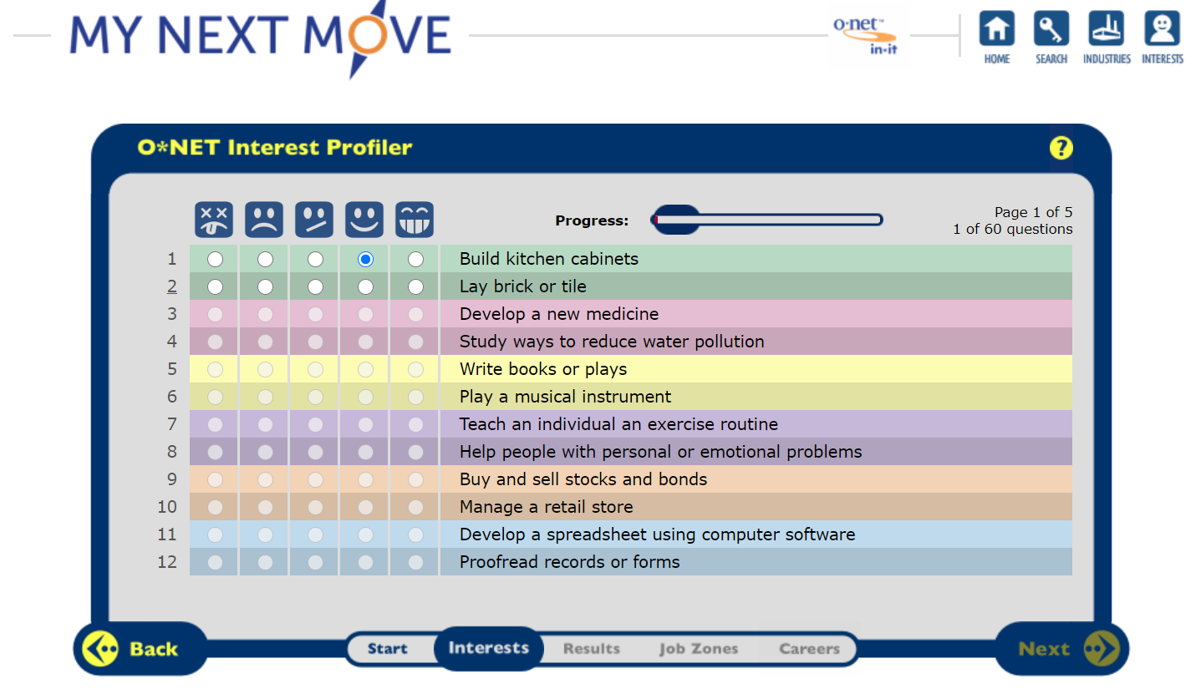
O*NET INTEREST PROFILER QUESTIONS
PG, p. 19
www.mynextmove.org/explore/ip

Slide 28
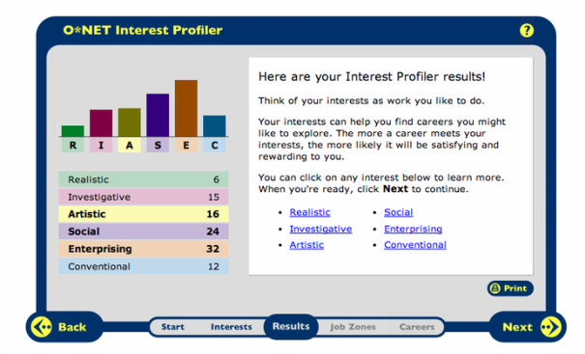
O*NET INTEREST PROFILER RESULTS
PG, p. 20
www.mynextmove.org/explore/ip

Slide 29
O*NET JOB ZONES
PG, p. 20
www.mynextmove.org/explore/ip

Slide 30
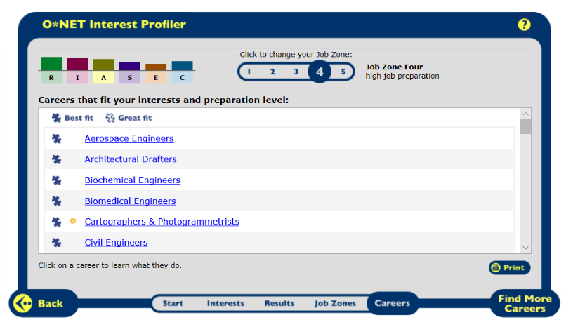
CAREER EXPLORATION
PG, p. 21
www.mynextmove.org/explore/ip

Slide 31
MY NEXT MOVE FOR VETERANS
PG, p. 21
www.mynextmove.org/vets

Slide 32
ACTIVITY: GAP ANALYSIS
WHERE AM I GOING?
Use the O*NET Interest Profiler, My Next Move for Veterans and COOL websites to find the following information:
Experience and Skill
Education and Training
Credentials (license, certification, certificate)
Complete the Where am I going? section of the Gap Analysis.
PG, p. 23

Slide 33
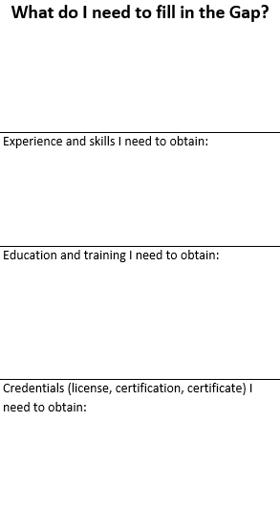
ACTIVITY: GAP ANALYSIS
WHAT DO I NEED TO FILL IN THE GAP?
Analyze your findings under Where am I now? and compare to Where am I going?
Fill in the What do I need to fill in the Gap?
Experience and Skill
Education and Training
Credentials (license, certification, certificate)
PG, p. 24

Slide 34
SUMMARY
Identified your current education, skills, abilities, experience, and credentials
Identified career opportunities based on your interests
Researched the requirements for your chosen career
Documented the gap between your current skill set and the requirements for your civilian career
PG, p. 25

Slide 35
NEXT STEPS
Complete a Gap Analysis or provide
verification of employment
CRS
Ensure your current Transition Track is correct
based on your Gap Analysis.
Make a plan to fill the gaps between your
current skills and those required for your
chosen civilian career field.
Contact your local personnel office and
confirm the accuracy of your official
military record.
PG, p. 25

Slide 36
QUESTIONS?
Reminder:
We are here to help YOU! If you have any questions at any point during your transition, please let us know.

Slide 37
We want your feedback!
Your feedback is anonymous and very valuable to the success of TAP. Every comment is read and addressed as appropriate.
TRANSITION ASSISTANCE PARTICIPANT ASSESSMENT
Use computer or mobile device
Go to: https://www.dodsurveys.mil/tap
Select MOC Crosswalk
Complete assessment
OR…SCAN THIS QR CODE WITH YOUR PERSONAL DEVICE TO BEGIN THE ASSESSMENT
PG, p. 25

