Slide 1
October 2022
Pre-Separation
Counseling

Slide 2
DISCLAIMER
The information provided herein does not constitute a formal endorsement of any company, its products, or services by the U.S. Department of Defense (DoD). Specifically, the appearance or use of external hyperlinks does not constitute endorsement by the DoD of the linked websites or the information, products, or services contained therein. The DoD does not exercise any editorial control over the information you may find at these locations. While this information provides informational resource material to assist military personnel and their families in identifying or exploring resources and options, the resources provided are not exhaustive.
All websites and URLs in this guide were active at the date of publication. However, web content is subject to change without notice. Users of this guide are advised to confirm information is current.

Slide 3
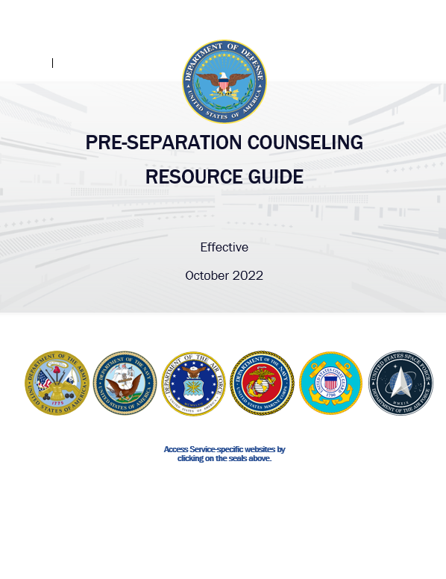
PRE-SEPARATION COUNSELING
RESOURCE GUIDE
1. Go to: www.TAPevents.mil/Resources.
2. Select the Pre-Separation Counseling Resource
Guide.
4. Download and save the Resource Guide on your
computer or email it to yourself if using a
government computer.
NOTE: The corresponding page of the Resource Guide (RG) will appear in
the left, bottom corner of each slide in this brief.
RG, p. 93

Slide 5
10 STEPS TO TRANSITION
STEP 1: Plan for Your Transition
STEP 2: Build Your Transition Team
STEP 3: Know Your VA Benefits
STEP 4: Plan for Health/Mental Care and Health Insurance
STEP 5: Plan for Civilian Employment/Vocational Training
STEP 6: Learn About Federal Employment
STEP 7: Plan for Further Education
STEP 8: Consider Starting a Business
STEP 9: Explore Additional Information and Benefits
STEP 10: Know Where to Go for Assistance
RG, p. 6

Slide 6
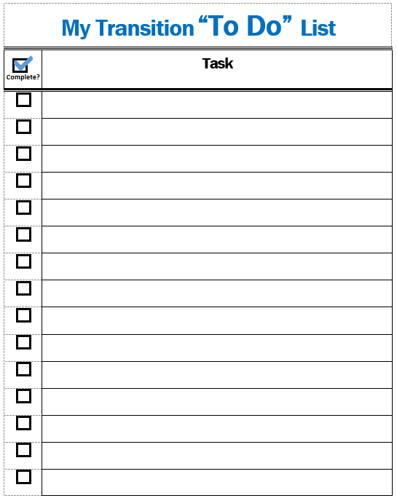
MY TRANSITION “TO DO” LIST AND NOTES PAGE
ACTIVITY
Throughout this brief, add the tasks you need to complete and take notes as you prepare for transition.
RG, p. 6

Slide 7
STEP 1:
Plan for Your Transition
STEP 2: Build Your Transition Team
STEP 3: Know Your VA Benefits
STEP 4: Plan for Health/Mental Care and Health Insurance
STEP 5: Plan for Civilian Employment/Vocational Training
STEP 6: Learn About Federal Employment
STEP 7: Plan for Further Education
STEP 8: Consider Starting a Business
STEP 9: Explore Additional Information and Benefits
STEP 10: Know Where to Go for Assistance
RG, p. 7

Slide 8
TRANSITION ASSISTANCE PROGRAM (TAP)
Congressionally mandated program that provides information, tools, and training to ensure Service members and their spouses are prepared for the next step in civilian life.
Title 10 U.S.C., Sections 1142, 1143, 1144
NDAA FY 19 John S. McCain, Section 552—Improvements to TAP
NDAA FY20, Sections 570c, 570f
DoDI 1332.35—TAP for Military Personnel
RG, p. 7

Slide 9
TAP OVERVIEW
You are here
Individualized Initial Counseling (IC)
Pre-Separation Counseling
Managing Your (MY) Transition
NLT 365 days
DoD Transition Day
DOL Employment Fundamentals of Career Transition
VA Benefits and Services
Financial Planning for Transition
MOC Crosswalk
2-Day Tracks
Continuum of Service
Capstone
Employment
Vocational
Education
Entrepreneurship
NLT 90 Days
RG, p. 8

Slide 10
CAREER
READINESS
STANDARDS
Individualized Initial Counseling
Deliverables assigned
CRS
Ensure you are ready for transition.
TAP Modules
Deliverables initiated
Capstone
Deliverables verified
RG, p. 8

Slide 11
GETTING STARTED
INDIVIDUALIZED INITIAL COUNSELING
CRS
Complete a personal self-assessment
Initiate an Individualized Transition Plan (ITP)
PRE-SEPARATION COUNSELING
RG, p. 8

Slide 12
INDIVIDUAL TRANSITION PLAN (ITP)
This slide is included for sites to add Service-specific
information about the ITP or a transition checklist.
See font and color details below.
HIDE slide if not used; do not DELETE slide as it may be needed for future presentations.
Title Font: 48-54 pts - Franklin Gothic Medium, All CAPS. | Body Font: Minimum 18 pts - Calibri Body Color Codes: Dark Blue - RGB (R: 30, G: 61, B: 88) | Light Blue - RBG (R: 0, G: 176, B: 240)

Slide 13
DD FORM 2648
Service Member Pre-Separation/Transition Counseling and Career Readiness Standards eForm for Service Members Separating, Retiring, Released from Active Duty (REFRAD)
DD eFORM 2648 tracks completion of all TAP requirements.
Initial Counseling: Initiated
Pre-Separation Counseling: e-Sign
Capstone: e-Sign
Filed in official military record
Save copy for your records
RG, p. 9

Slide 14
TAP CORE CURRICULUM:
DoD/DHS Transition Day
MANAGING YOUR (MY) TRANSITION
MOC CROSSWALK
CRS
Complete a Gap Analysis or provide verification of employment
FINANCIAL PLANNING FOR TRANSITION
CRS
Prepare a criterion-based, post-separation financial plan
RG, p.10
RG, p. X

Slide 15
TAP CORE CURRICULUM:
VA Benefits and Services
CRS
Register on VA.gov
RG, p. 11
RG, p. X

Slide 16
TAP CORE CURRICULUM:
DOL one-day workshop
Employment Fundamentals for Career Transition (EFCT)
Introduces the essential tools and resources to evaluate career options.
Provides key information for civilian employment.
Explains the fundamentals of the employment process.
RG, p. 11

Slide 17
EMPLOYMENT
2-DAY
TRACKS
CRS
Complete a resume or provide verification of employment
VOCATIONAL
CRS
Complete a comparison of technical training institution options
EDUCATION
CRS
Complete a comparison of higher education institution options
ENTREPRENEURSHIP
RG, p. 11

Slide 18
2-DAY TRACKS
ENTREPRENEURSHIP ( Boots to Business (B2B)
Contact the Military & Family Readiness Center to register
719-556-6141
VOCATIONAL (Career & Credentialing Exploration (C2E)
Contact the Military & Family Readiness Center to register
719-556-6141

Slide 19
CONTINUUM OF MILITARY
SERVICE OPPORTUNITY
Air National Guard (719-359-6356) & Air Force Reserve (719-556-0151) briefing will be held during TAP

Slide 20
CAPSTONE
This slide is included for sites to add site-specific
information about the Capstone process.
See font and color details below.
HIDE slide if not used; do not DELETE slide as it may be needed for future presentations.
Title Font: 48-54 pts - Franklin Gothic Medium, All CAPS. | Body Font: Minimum 18 pts - Calibri Body Color Codes: Dark Blue - RGB (R: 30, G: 61, B: 88) | Light Blue - RBG (R: 0, G: 176, B: 240)

Slide 21
CAREER
READINESS
STANDARDS
Completed | CRS | Course/Brief
 | Start a personal self-assessment/ Individual Transition Plan (ITP) | IC/Pre-Separation Counseling
 | Complete a Gap Analysis or provide verification of employment | MOC Crosswalk
 | Prepare a criterion-based, post-separation financial plan | Financial Planning for Transition
 | Register on VA.gov | VA Benefits and Services
 | Complete a resume or provide verification of employment | DOL Employment Workshop
 | Complete a comparison of higher education or technical training institution options | DoD Managing Your Education/ DOL Career Credential Exploration
 | Complete a continuum of Military Service Opportunity counseling (Active-component only) | By Installation
RG, p. 13

Slide 22
DS LOGON & LOGIN.GOV
https://myaccess.dmdc.osd.mil/
Login.gov
MilConnect
DFAS
TRICARE OnLine
VA.gov
Social Security Benefits
Small Business Loans
USAJobs
RG, p. 14

Slide 23
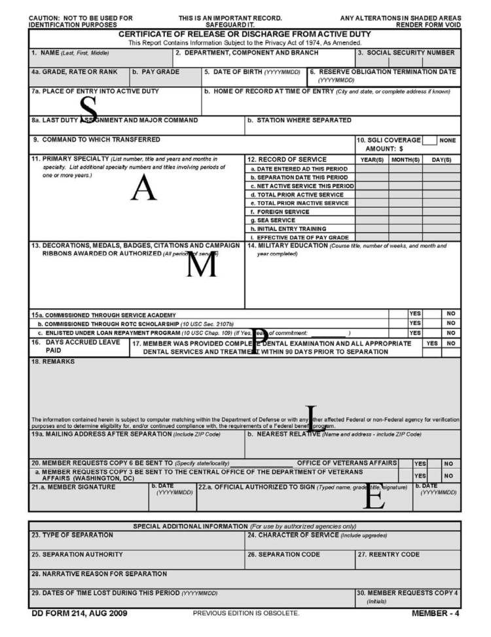
DD Form 214
Certificate of Release or Discharge
from Active Duty
Your DD 214 is the key to
unlocking all future benefits.
BEFORE TRANSITION:
Review the dates and locations of Service on your DD 214 CAREFULLY.
Have mistakes corrected.
Safeguard your DD 214!
RG, p. 15

Slide 24
MY transition timeline
Located on
www.DoDTAP.mil under Resources/FAQs
RG, p. 16

Slide 25
SERVICE TRANSITION TIMELINE
This slide is included for sites to add a Service-specific transition timeline.
See font and color details below.
HIDE slide if not used; do not DELETE slide as it may be needed for future presentations.
Title Font: 48-54 pts - Franklin Gothic Medium, All CAPS. | Body Font: Minimum 18 pts - Calibri Body Color Codes: Dark Blue - RGB (R: 30, G: 61, B: 88) | Light Blue - RBG (R: 0, G: 176, B: 240)

Slide 26
STEP 1: Plan for Your Transition
STEP 2:
Build Your Transition Team
STEP 3: Know Your VA Benefits
STEP 4: Plan for Health/Mental Care and Health Insurance
STEP 5: Plan for Civilian Employment/Vocational Training
STEP 6: Learn About Federal Employment
STEP 7: Plan for Further Education
STEP 8: Consider Starting a Business
STEP 9: Explore Additional Information and Benefits
STEP 10: Know Where to Go for Assistance
RG, p. 18

Slide 27
Installation Resources
YOUR
TRANSITION
TEAM
Military & Family Support Staff
Service Transition or TAP Office
VA Benefits Advisor
Chaplains, Health Professionals, Education Office
Off-installation Resources
American Job Centers
Vet Centers
Military OneSource
Military and Veteran Service Organizations
RG, p. 18

Slide 28
INTERAGENCY PARTNERS
DoD TAP
DOL VETS
VA Veterans Resources
SBA Office of Veteran Business Development
RG, p. 20

Slide 29
ADDITIONAL
SUPPORT SOURCES
Military Family Live Counselor (MFLC)
719-342-9572
MilitaryOneSource - www.militaryonesource.com
1-800-342-9647
Chaplain Services
719-556-4442
Sexual Assault and Prevention and Response
719-556-7272
Education Office
719-556-4996
Airman & Family Readiness Center
719-556-6141

Slide 30
STEP 1: Plan for Your Transition
STEP 2: Build Your Transition Team
STEP 3:
Know Your VA Benefits
STEP 4: Plan for Health/Mental Care and Health Insurance
STEP 5: Plan for Civilian Employment/Vocational Training
STEP 6: Learn About Federal Employment
STEP 7: Plan for Further Education
STEP 8: Consider Starting a Business
STEP 9: Explore Additional Information and Benefits
STEP 10: Know Where to Go for Assistance
RG, p. 24

Slide 31
VA BENEFITS AND SERVICES
VA Benefits Advisors discuss VA benefits over 6 modules:
Navigating the Journey
Supporting Yourself and Your Family
Getting Career Ready
Finding a Place to Live
Maintaining Your Health
Connecting with Your Community
1
2
3
4
5
6
RG, p. 24

Slide 32
VA Information –
Resource guide
VA Education Benefits
Transfer GI Bill
Veteran Readiness & Employment (VR&E)
VA Home Loan Guarantee
VA Life Insurance
State VA Offices
VA Vet Centers
VA Solid Start
VA Disability
Benefits Delivery at Discharge
VA Health Care
VA Women’s Health
Transition Care Management (TCM)
VA Mental Health Care
Personalized Career Planning and Guidance (PCPG)
RG, p. 25

Slide 33
VA DISABILITY BENEFITS:
Benefits Delivery at Discharge
What
Benefits Delivery at Discharge (BDD) provides VA disability compensation (pay) from day of discharge.
Service members meeting the requirements begin the BDD claim process within 180 – 90 days from discharge.
Meet with a VA Benefits Advisor to determine if this option is right for you.
Who
How
RG, p. 25

Slide 34
TRANSFER OF BENEFITS
Failure to complete the obligated Service before separating may require any benefits used to be repaid.
Criteria for active-duty Service member to transfer Post-9/11 GI Bill benefits
Served a minimum of 6 years
Agree to add 4 more years of Service
Recipient of benefits has enrolled in DEERS
AND
AND
RG, p. 30

Slide 35
STATE VA OFFICES
Assist in identifying and accessing benefits after separation or retirement.
Each state manages its own VA Office; therefore, each state’s level of assistance will vary.
https://www.va.gov/statedva.htm
RG, p. 35

Slide 36
VA SOLID START
Follow up phone calls from VA at 90, 180, 365 days after separation.
Reminder emails with links to resources.
Update contact information at VA.gov prior to separation/retirement.
RG, p. 35

Slide 37
VA BENEFITS ADVISOR(S)
This slide is included for sites to add contact information for their site VA Benefits Advisor(s). See font and color details below.
HIDE slide if not used; do not DELETE slide as it may be needed for future presentations.
Title Font: 48-54 pts - Franklin Gothic Medium, All CAPS. | Body Font: Minimum 18 pts - Calibri Body Color Codes: Dark Blue - RGB (R: 30, G: 61, B: 88) | Light Blue - RBG (R: 0, G: 176, B: 240)

Slide 38
STEP 1: Plan for Your Transition
STEP 2: Build Your Transition Team
STEP 3: Know Your VA Benefits
STEP 4:
Plan for Health/Mental Care and Health Insurance
STEP 5: Plan for Civilian Employment/Vocational Training
STEP 6: Learn About Federal Employment
STEP 7: Plan for Further Education
STEP 8: Consider Starting a Business
STEP 9: Explore Additional Information and Benefits
STEP 10: Know Where to Go for Assistance
RG, p. 37

Slide 39
Required Health Assessments
TRICARE Online contains a Service Separation tab which provides the steps necessary to start the process.
SEPARATION HISTORY
AND PHYSICAL
EXAMINATION (SHPE)
OR
SEPARATION HEALTH ASSESSMENT (SHA)
AND
MENTAL HEALTH ASSESSMENT (MHA)
Either SHPE (DoD conducted) or SHA (VA conducted) is required prior to separation or release from active duty.
Either SHA (VA conducted) or SHPE (DoD conducted) is required prior to separation or release from active duty.
MHA is required prior to SHPE or SHA and will be included as part of the appointment.
SHA is required for VA disability claims.
!
Confirm your Service Treatment Record (STR) or Military Medical Record includes all medical aid received on AND off installation. To make a SHPE appointment call 556-1156
RG, p. 37

Slide 40
DoD inTRANSITION PROGRAM
Available to ALL Service members regardless of length of Service or discharge status
No expiration date to enroll
Free, confidential coaching and assistance for Service members who require mental health services.
Automatically enrolled if seen by a behavioral health provider within 1 year of separation from active duty*
RG, p. 39
*May opt out

Slide 41
VETERANS/MILITARY CRISIS LINE
Save this information in your phone to assist friends and family
Text: 838255
Dial: 988; Press 1
Chat: www.VeteransCrisisLine.net
RG, p. 40

Slide 42
SEXUAL ASSAULT
PREVENTION AND
RESPONSE
PROGRAM
Sexual harassment
Sexual assault
Intimate Partner Violence (IPV)
Contact the Peterson SFB, SAPR Victim Advocate at 719-556-7272 or Safe Helpline if you have been a victim of Sexual Assault
RG, p. 41

Slide 43
TRICARE HEALTH CARE PLAN
Schedule an appointment with TRICARE representative.
Visit the Plan Finder on the TRICARE website.
Retirees who fail to enroll in TRICARE Prime or TRICARE Select will lose all TRICARE coverage.
RG, p. 42

Slide 44
TRANSITIONAL/TEMPORARY
HEALTH CARE COVERAGE
Continued Health Care Benefits Program (CHCBP)
Transitional Assistance Management Program (TAMP)
RG, p. 45

Slide 45
HEALTH INSURANCE
MARKETPLACE
The Marketplace helps uninsured people find health coverage.
Plans cover essential health benefits, pre-existing conditions, and preventive care.
More information will be provided during the Financial Planning for Transition module.
RG, p. 48

Slide 46
STEP 1: Plan for Your Transition
STEP 2: Build Your Transition Team
STEP 3: Know Your VA Benefits
STEP 4: Plan for Health/Mental Care and Health Insurance
STEP 5:
Plan for Civilian Employment/Vocational Training
STEP 6: Learn About Federal Employment
STEP 7: Plan for Further Education
STEP 8: Consider Starting a Business
STEP 9: Explore Additional Information and Benefits
STEP 10: Know Where to Go for Assistance
RG, p. 49

Slide 47
DOL
EMPLOYMENT
TRACK:
Employment Workshop
(DOLEW)
Identifying Skills
Job Searching
Networking
Resume Building
Federal Hiring
Social Media
Branding
Applications
Interviews
Job Offers
EMPLOYMENT
CRS
Complete a resume or provide verification of employment
RG, p. 49

Slide 48
DOL VOCATIONAL
TRACK:
Career and Credentialing Exploration (C2E)
Vocational Training
Career Clusters
Career Assessments
Resources
Labor Markets
Experience Opportunities
Credentials
Educational Goals
Career Action Plan
VOCATIONAL
CRS
Complete a comparison of technical training institution options
RG, p. 49

Slide 49
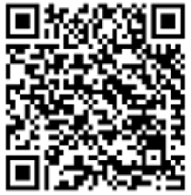
EMPLOYMENT NAVIGATORS
Employment Navigators provide assistance with…
Self-Assessments
Skills Testing
Career Exploration
Identification of high-demand careers
Identification of necessary credentials
Review of detailed labor market information
Resume Review
Connections to partners for additional employment services
Looking for direction for your next career? Not sure how to identify your “good fit” career field?
We can help.
Schedule your appointment today.
Scan the QR code with your phone camera. Scroll down to schedule your appointment online.
For more information or to connect with an Employment Navigator, go to
https://www.dol.gov/agencies/vets/programs/tap/employment-navigator-partnership

Slide 50
DOL Transition Employment Assistance
for Military Spouses
AND CAREGIVERS (TEAMS)
Your Next Move
Career Credentials
Marketing Me
Resume Essentials
Federal Hiring
Interview Skills
LinkedIn Profiles/Job Search
Salary Negotiations
RG, p. 50

Slide 51
DOL RESOURCES
Career One Stop website
American Job Centers (AJC)
Priority of Service
State Job Banks
Unemployment Compensation
RG, p. 52

Slide 52
IDENTIFYING SKILLS & INTERESTS
O*NET Online
Interest Profiler
My Next Move for Veterans
Verification of Military Experience and Training
(VMET)
DD Form 2586
RG, p. 53

Slide 53
CREDENTIALING
Licenses
Certifications
Credentialing Opportunities On-Line (COOL)
MilGears
milgears.osd.mil
RG, p. 55

Slide 54
GAINING EXPERIENCE
Apprenticeships/OJT
United States Military Apprenticeship Program (USMAP)
DoD SkillBridge
Volunteering
AmeriCorps
RG, p. 58

Slide 55
UNIFORMED SERVICE EMPLOYMENT AND REEMPLOYMENT RIGHTS ACT (USERRA)
Federal law that establishes rights and responsibilities for uniformed Service members and their civilian employers
Active Duty, National Guard, and Reserve Members covered by USERRA
More information provided during DOL modules
RG, p. 61

Slide 56
STEP 1: Plan for Your Transition
STEP 2: Build Your Transition Team
STEP 3: Know Your VA Benefits
STEP 4: Plan for Health/Mental Care and Health Insurance
STEP 5: Plan for Civilian Employment/Vocational Training
STEP 6:
Learn About Federal Employment
STEP 7: Plan for Further Education
STEP 8: Consider Starting a Business
STEP 9: Explore Additional Information and Benefits
STEP 10: Know Where to Go for Assistance
RG, p. 63

Slide 57
FEDERAL EMPLOYMENT OPPORTUNITIES
Feds Hire Vets and USAJobs
Veterans Preference
Special Appointing Authority for Veterans
Veterans Employment Opportunities Act (VEOA)
Veterans Recruitment Appointment (VRA)
Thirty Percent or More Disabled Veterans
RG, p. 63

Slide 58
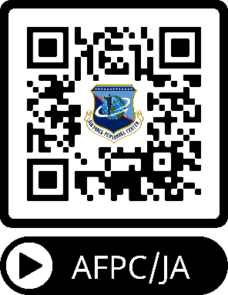
180-Day Restriction on DoD
Employment of Military Retirees
POST-MILITARY
EMPLOYMENT
RESTRICTIONS
Post-Government (Military) Service
Employment Restriction Counseling
RG, p. 66
Notes:
Everyone should have received the link for the AFPC/JA video concerning Post-Military Employment Restrictions and Foreign Government Employment Requirements. This information can also be found on pages 66-68 in your Resource Guide. You can access the video using the QR code on this slide and the next slide has an additional site and information. Remember to consult our installation JA with any questions/concerns.

Slide 59
FOREIGN
GOVERNMENT
EMPLOYMENT
(FGE)
All DAF retirees must acknowledge:
Joint approval from SecAF and SecState is required prior to accepting employment with a foreign government or entity
Compensation without prior FGE approval is subject to recoupment from retired pay
Receipt of FGE briefing or viewing of AFPC/JA video vignette on post / foreign government employment
Circumstances requiring FGE approval are not always apparent; retiring members must consult a legal/ethics official when considering employment that may be considered FGE
For additional information visit:
https://www.retirees.af.mil/Foreign-Government-Employment/
RG, p. 68
Notes:
A few items to specially highlight concerning Foreign Government Employment: All Department of the Air Force retirees must have a statement added in the remarks section that acknowledges approval from by the Secretary of the Air Force and the Secretary of State is required prior to accepting employment with a foreign government or entity. Compensation without prior FGE approval is subject to recoupment (garnishment) from retired pay; and that you have been briefed concerning Post-military Employment restrictions and Foreign Government Employment Requirements.

Slide 60
STEP 1: Plan for Your Transition
STEP 2: Build Your Transition Team
STEP 3: Know Your VA Benefits
STEP 4: Plan for Health/Mental Care and Health Insurance
STEP 5: Plan for Civilian Employment/Vocational Training
STEP 6: Learn About Federal Employment
STEP 7:
Plan for Further Education
STEP 8: Consider Starting a Business
STEP 9: Explore Additional Information and Benefits
STEP 10: Know Where to Go for Assistance
RG, p. 70

Slide 61
DoD EDUCATION
TRACK:
Managing Your (MY) Education
Education Terms
Reasons for Earning a Degree
Choosing a Field of Study
Degree Options
Choosing an Institution
Gaining Admission
Transfer Credit
Funding Options
EDUCATION
CRS
Complete a comparison of higher education institution options. Contact the Peterson Education Office at 719-556-4996.
RG, p. 70

Slide 62
EDUCATION ASSISTANCE RESOURCES
Service Education Counselors resources:
College level-testing
Veterans’ Benefits
Tuition Assistance
Financial Aid Assistance
Deferments for military service
DANTES sponsored resources:
Kuder Journey
Online Academic Skills Training for College Prep/Placement Tests
CLEP or College Credit-by-Exam
Military Training Evaluation Program (MTEP)
Joint Service Transcript (JST)
Community College of Air Force (CCAF) Transcript
RG, p. 70

Slide 63
STATE AND
FEDERAL PROGRAMS
State and Local Educational Benefits
Department of Education Federal Programs/Benefits:
Federal Student Aid—Complete the FAFSA by October 1st
Grants
Loans
Work-Study Programs
Veterans Upward Bound Program
RG, p. 73

Slide 64
STEP 1: Plan for Your Transition
STEP 2: Build Your Transition Team
STEP 3: Know Your VA Benefits
STEP 4: Plan for Health/Mental Care and Health Insurance
STEP 5: Plan for Civilian Employment/Vocational Training
STEP 6: Learn About Federal Employment
STEP 7: Plan for Further Education
STEP 8:
Consider Starting a Business
STEP 9: Explore Additional Information and Benefits
STEP 10: Know Where to Go for Assistance
RG, p. 75

Slide 65
SBA ENTREPRENEURSHIP
TRACK:
Boots to Business (B2B)
Fundamentals
Opportunities
Market Research
SmallBiz Economics
Legal
Financing
ENTREPRENEURSHIP
RG, p. 75

Slide 66
Veteran entrepreneurship is supported by SBA, VA, and DoD through the following legislation and programs:
SBA—Small Business Development Act 1999 created goals for veteran contracts.
DoD Procurement Technical Assistance Center Program helps businesses pursue government contracts.
VA Small and Veteran Business Program provides support to small and veteran businesses.
VETERANS FEDERAL
PROCUREMENT
OPPORTUNITIES &
ASSISTANCE
RG, p. 76

Slide 67
STEP 1: Plan for Your Transition
STEP 2: Build Your Transition Team
STEP 3: Know Your VA Benefits
STEP 4: Plan for Health/Mental Care and Health Insurance
STEP 5: Plan for Civilian Employment/Vocational Training
STEP 6: Learn About Federal Employment
STEP 7: Plan for Further Education
STEP 8: Consider Starting a Business
STEP 9:
Explore Additional Information and Benefits
STEP 10: Know Where to Go for Assistance
RG, p. 78

Slide 68
EXTREMISM
REPORTING METHODS
For an emergency, call 911
FBI-Tips Electronic Tip Form: https://tips.fbi.gov/
Local FBI offices: https://www.fbi.gov/contact-us/field-offices
RG, p. 78

Slide 69
VETERAN CITIZENSHIP
Former Air Force and Space Force members should:
Encourage young citizens to consider a period of military service
Honorably represent the Armed Forces in their communities
Educate their fellow citizens on military core values while respecting their fellow citizen’s right to have and express contrary opinions
Be aware that certain predatory financial (including investment and lending), insurance and estate planning institutions may market products and services of questionable value to former military personnel and may try to falsely lead Veterans to believe that they are obtaining special discounts or rates as a result of their military service
Former Air Force and Space Force members may:
Wear their uniform at Memorial Day, Veteran’s Day, and other patriotic celebratory events
RG, p. 77
Notes:
Veterans and Retirees are held in special regard by their fellow American citizens. They are deemed to have informed opinions on military matters and tales of their time on active duty are received with interest, respect and a presumption of accuracy and truth. To safeguard America’s esteem for future generations of military members, we do not want to abuse the trust we have earned.
As former members of the military in a society where most do not serve in their Armed Forces, we do have special knowledge. After we leave active duty, we should return to our communities and share our perspectives on national security events and life in the military. We should encourage young people who cross our paths to at least consider a period of military services and the advantages (e.g., confidence, technical skills, educational benefits, travel) it can bring. On Memorial Day, Veteran’s Day, and other holidays and events that honor military service, we may wear our former uniform with pride. Even a brief time in military service instills core values for a lifetime and we should share those lessons learned with our fellow citizens, while always respecting their right to disagree with us and have contrary opinions.

Slide 70
VETERAN CITIZENSHIP
Former Air Force and Space Force members should not:
Exaggerate their military accomplishments (particularly records of combat service or acts of valor) or wear unearned medals/insignia
Disparage their Veteran status by being a member of; actively participating in; or advocating for or on behalf of supremacist, criminal, extremist, or hate groups/organizations, their causes, or their ideals
Supremacist or extremist groups/organizations are those that advance, encourage, or advocate:
illegal discrimination based on race, creed, color, gender, sexual orientation, religion, ethnicity, or national origin;
advocate the illegal use of force, violence, or criminal activity; or
otherwise engage in efforts to deprive individuals of their civil rights
RG, p. 77
Notes:
Veterans and Retirees should always give an accurate, unclassified and humble account of their military service. We should avoid the temptation to exaggerate our exploits, particularly our service in combat or our military awards and decorations. The Stolen Valor Act of 2013 (Public Law 113-72) actually makes it a Federal crime to falsely claim military service, a military grade or decorations of valor, with the intent of obtaining money, property or other tangible benefits.
Former military members should also be wary of businesses and individuals that may want to take advantage of our special status. Certain unsavory financial institutions (including banking, investment, mortgage and other lending, insurance and estate planning) may try to falsely offer special discounts or rates based on military status.
Lastly, extremism in America is a real and persistent threat and Veterans and Retirees are often targeted by extremist, supremacist, and criminal groups who value their knowledge, discipline, tactical skills and military affiliation. As military members, we start our careers swearing an oath to support and defend the Constitution of the United States against all enemies, foreign and domestic. This oath should continue as a reminder of the moral obligations of being a veteran of military service. Actions that go against the fundamental principles of the oath we share, including actions associated with extremist or dissident ideologies, should not be tolerated after military service – the same as they were not tolerated during military service.

Slide 71
IMMIGRATION STATUS
Request information on immigration status and expedited naturalization:
DD 2648 eForm—Opt in
DD 2648 printed form—Write an “opt in” election in Section XI – REMARKS, item 48
RG, p. 79

Slide 72
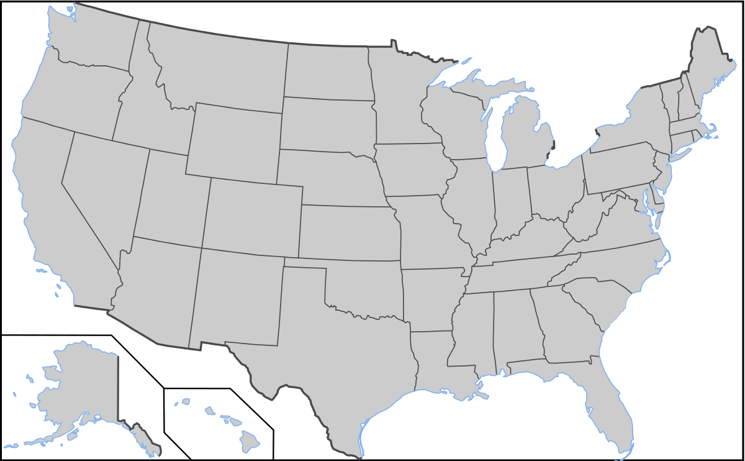
Opt-in FOR STATE information
1
Opt-in with your civilian email on the DD 2648
Indicate the state or states where you may live after transition
State representatives will contact you with information on employment, housing, education, etc.
2
3
RG, p. 79

Slide 73
ADDITIONAL INFORMATION
Separation Pay
Thrift Savings Plan (TSP)
Survivor Benefit Plan (SBP)
Legal Assistance
Military Protections/Tax Benefits
Travel/Transportation Allowances
Permissive TDY/Excess Leave
Housing Assistance/Homelessness
Voting Assistance
Adaptive Tools for Service Members
Commissary, Exchange, MWR
RG, p. 80

Slide 74
STEP 1: Plan for Your Transition
STEP 2: Build Your Transition Team
STEP 3: Know Your VA Benefits
STEP 4: Plan for Health/Mental Care and Health Insurance
STEP 5: Plan for Civilian Employment/Vocational Training
STEP 6: Learn About Federal Employment
STEP 7: Plan for Further Education
STEP 8: Consider Starting a Business
STEP 9: Explore Additional Information and Benefits
STEP 10:
Know Where to Go for Assistance
RG, p. 90

Slide 75
INSTALLATION RESOURCES
This slide is included for sites to add site-specific
information about Installation Resources.
See font and color details below.
HIDE slide if not used; do not DELETE slide as it may be needed for future presentations.
Title Font: 48-54 pts - Franklin Gothic Medium, All CAPS. | Body Font: Minimum 18 pts - Calibri Body Color Codes: Dark Blue - RGB (R: 30, G: 61, B: 88) | Light Blue - RBG (R: 0, G: 176, B: 240)

Slide 76
TAP TRANSITION
ONLINE LEARNING (TOL)
Managing Your (MY) Transition
MOC Crosswalk
Financial Planning for Transition
VA Benefits and Services
Employment Fundamentals for Career Transition
www.TAPevents.org
DOL Employment Track: Employment Workshop (DOLEW)
DOL Vocational Track: Career and Credential Exploration (C2E)
DOD Education Track: Managing Your (MY) Education (MYE)
SBA Entrepreneurship Track: Boots to Business (B2B)
RG, p. 90

Slide 77
MILITARY LIFE CYCLE (MLC) COURSES
Transitioning to Federal Employment
Reserve Component Dual Payments
Social and Emotional Health Resources
Survivor and Casualty Assistance Resources
VA Benefits 101
VA Education Benefits
VA Home Loan Guaranty Program
VA Life Insurance Benefits
Vet Centers
RG, p. 91

Slide 78
Embrace the journey. Embrace the change. Growth doesn’t come from things staying the same.
~Unknown
RG, p. 92

Slide 79
INSTALLATION RESOURCES
This slide is included for sites to add site-specific
information about Installation Resources.
See font and color details below.
HIDE slide if not used; do not DELETE slide as it may be needed for future presentations.
Title Font: 48-54 pts - Franklin Gothic Medium, All CAPS. | Body Font: Minimum 18 pts - Calibri Body Color Codes: Dark Blue - RGB (R: 30, G: 61, B: 88) | Light Blue - RBG (R: 0, G: 176, B: 240)
Notes:
Air Force JROTC is a Congressionally-mandated high school citizenship program
Not a recruiting program!
Air Force JROTC only hires retired Airmen (Active, Guard, Reserve)
Air Force JROTC:
Operates in nearly 900 high schools (49 states, 17 overseas locations)
Has more than 120,000 students (cadets) enrolled annually
Has nearly 1,900 instructors (all retired Air Force)
Performs over 1.6 million hours of community service annually
Offers a variety of academics and activities to engage today’s youth
Air Force JROTC Instructors:
Are hired by schools year round
Are always needed…always have vacancies that need to be filled
May be retired officer (O4-O6) or retired enlisted (E6-E9)
Must be retired less than 5 years
Are certified by the Air Force, but are employees of the school district
Are paid by the school district
Receive at least the Minimum Instructor Pay (MIP)
MIP is based on each retiree’s grade and years of service
More information on the program, pay, and how to apply can be found at: https://www.airuniversity.af.edu/Holm-Center/AFJROTC/

Slide 81
QUESTIONS?
Reminder:
We are here to help YOU! If you have any questions at any point during your transition, please let us know.

